Slide 1

Subject Name - Chemistry NEET
Class - 12th NEET
Chapter Name – Alcohols, Phenols And Ethers
PPT No.- 01/04

Slide 2
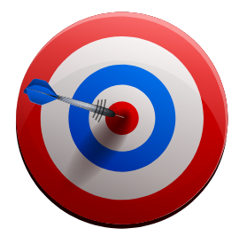
Unlocking New Perspective
These classes of compounds find wide applications in industry as well as in day-to-day life. For instance, have you ever noticed that ordinary spirit used for polishing wooden furniture is chiefly a compound containing hydroxyl group, ethanol.
Just think of life without paper; no note-books, books, newspapers, currency notes, cheques, etc. The magazines carrying beautiful photographs and interesting stories would disappear from our life. It would have been really a different world.

Slide 3
Previous Year Exam Analysis
NEET YEAR WISE ANALYSIS
Numbers of questions

Slide 4
PPT CONTENT
Sr. No. | TOPICS
1. | Introduction to Alcohols
2. | Classification of Alcohols
3. | IUPAC Nomenclature of Alcohols
4. | Preparation Methods of Alcohols
5. | Some Important Alcohols

Slide 5
INTRODUCTION
An alcohol contains one or more hydroxyl (OH) group(s) directly attached to carbon atom(s), of an aliphatic system (CH₃OH) while a phenol contains –OH group(s) directly attached to carbon atom(s) of an aromatic system (C₆H₅OH).
The substitution of a hydrogen atom in a hydrocarbon by an alkoxy or aryloxy group (R–O/Ar–O) yields another class of compounds known as ‘ethers’, for example, CH₃OCH₃ (dimethyl ether)

Slide 6
Question
#Q. Write the general formula of alcohols
A
C_{n}H_{2n}
C_{n}H_{2n+2}
C_{n}H_{2n+1} OH
C_{n}H_{2n+1}COOH
B
C
D
Notes:
Ans. (C)

Slide 7
Topic : Alcohols
Alcohols are the hydroxyl derivatives of hydrocarbons in which one or more hydrogen atoms are replaced by corresponding number of hydroxyl (–OH) group(s).
+ OH
R – H R – OH
– H
(Alkane) (alcohol)
(Hydrocarbon)
For e.g. H₃C – OH (Methyl alcohol),
H₅C₂ – OH (Ethyl alcohol), etc.

Slide 8
Question
#Q. Functional group of an alcohol is:
A
– O –
– OH
– C – OH
– CHO
B
C
||
O
D
Notes:
Ans. (B)

Slide 9
Question
#Q. Alcohols are ₋₋₋₋₋₋₋₋ derivatives of hydrocarbons
A
Keto
Hydroxyl
Aldehyde
Halogen
B
C
D
Notes:
Ans. (B)

Slide 10
Topic : Classification of Alcohols
1. Monohydric alcohols
2. Dihydric alcohols
3. Trihydric alcohols
4. Polyhydric alcohols

Slide 11
1. Monohydric alcohols
(Contains only one – OH group)
For e.g.. CH₃ – OH (Methyl alcohol)

Slide 12
2. Dihydric alcohols (Contain two – OH group)
Gem diol
Vic diol

Slide 13
3. Trihydric alcohols (Contain three – OH group)
For e.g..
1 2 3
CH₂ – CH – CH₂
Common Name: Glycerol / Glycerin
| | |
OH OH OH
IUPAC Name: Propane – 1, 2 ,3 – triol

Slide 14
4. Polyhydric alcohols (Contains four or more than four – OH group)
For e.g..
CH₂ – (CHOH)₄ – CH₂
| |
Common Name: Sorbitol
OH OH

Slide 15
According to the type of hybridization of the Carbon atom to which the hydroxyl group is attached :
Compounds containing C_{sp3} – OH bond :
i)Allylic
ii)Benzylic
Compounds containing C_{sp2} – OH bond:
i)Vinylic

Slide 16

Question
#Q. Which is the correct match from the following?
A
Vic diol $→$ HO—CH₂—CH₂—OH
Allylic alcohol $→$ CH₂=CH—CH₂—OH
Propargyl alcohol $→$ CH$≡$C—CH₂—OH
All are correct
B
C
D
Notes:
Ans. (D)

Slide 17
Question
#Q. CH₂ – CH – CH₂
| | |
OH OH OH
A
Mono hydric alcohol
Di hydric alcohol
Tri hydric alcohol
Tetra hydric alcohol
B
C
D
Notes:
Ans. (C)

Slide 18
On the Basis of degree of Carbon
There are three types of Alkyl alcohols
Primary (1°) alcohols
Secondary (2°) alcohols
Tertiary (3°) alcohols

Slide 19
Topic : Alkyl Alcohols
Primary (1°) alcohols
In primary alcohols hydroxyl group is attached to 1° Carbon atom or Primary carbon.
For e.g..
H₃C – CH₂ – OH

Slide 20
Secondary (2°) alcohols
In secondary alcohols hydroxyl group is attached to 2° Carbon atom.
For e.g..
H₃C – CH – CH₃
(Iso/sec – propyl alcohol)
IUPAC Name: Propanol-2 or Propan-2-ol
|
OH

Slide 21
Tertiary (3°) alcohols
In tertiary alcohols hydroxyl group is attached to 3° or Tertiary carbon atom)
For e.g..
CH₃
|
H₃C – C* – OH
*C is 3° - Carbon
|
CH₃
Tertiary – butyl alcohol (or) Tert-butylalcohol
IUPAC Name: 2-methylpropan-2-ol

Slide 22
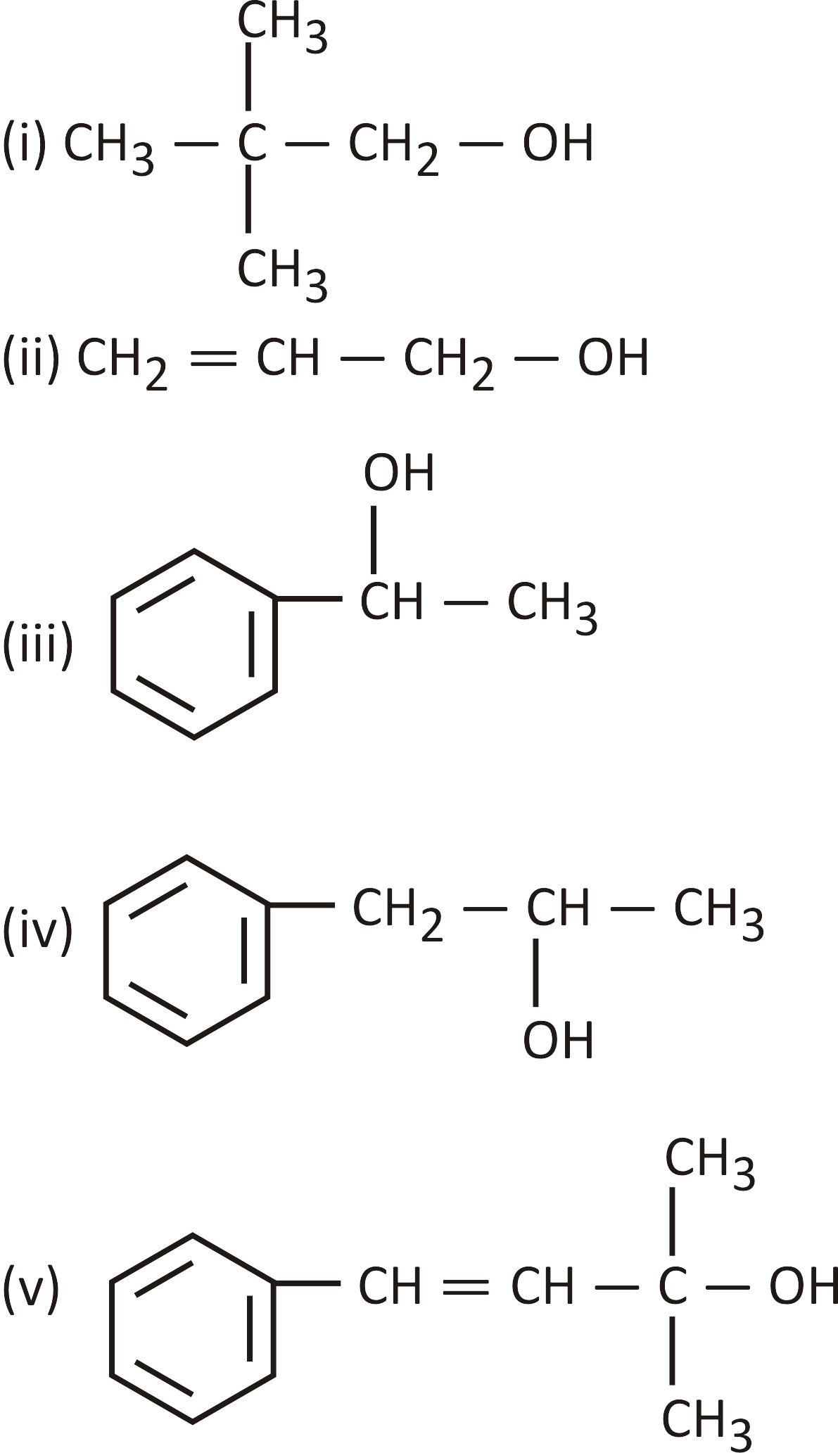
Question
#Q. Identification of degree of alcohol
[NCERT]
Notes:
Hint: Identify alcohols as primary, secondary and tertiary

Slide 23
Question
#Q. Which one of the following is a secondary alcohol?
A
2 - methyl -2- propanol
1- propanol
1- butanol
2- pentanol
B
C
D
Notes:
Ans. (D)

Slide 24
Topic : IUPAC Nomenclature of Alcohols
I.U.P.A.C Nomenclature
Root word + an + ol =
Common name :- alkyl group + alcohol

Slide 25
Topic : Nomenclature
No.
Structure
Common Name
Common name:- common name of alkyl group(Methyl) + alcohol =Methyl alcohol
1.
H₃C – OH
Methyl alcohol
I.U.P.A.C. Name
Methanol
Root word +an + ol = Meth + an + ol = Methanol

Slide 26
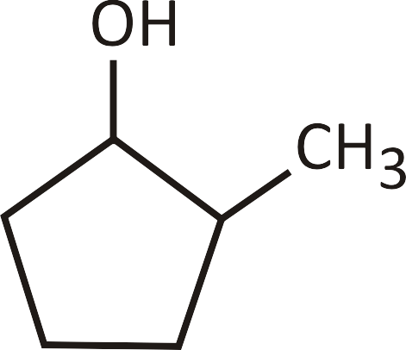
Question
#Q. Give the IUPAC name of the following:
[NCERT]
A
Isobutyl alcohol
Glycerol
Ethylene glycol
B
C
D
Notes:
Ans. (a) 2-methylpropan-1-ol, (b) Propane-1,2,3-triol, (c) 2-Methylcyclopentanol, (d) Ethane-1,2-diol

Slide 27
Question
CH₃
IUPAC name of
H₃C – C – OH
CH₃
A
2 – Methylpropan – 1 – ol
2 – Methylpropan – 2 – ol
1 – Methylpropan – 3 – ol
2 – Methylpropan – 2 – ol
B
C
D
Notes:
Ans. (B)

Slide 28
Question
CH₃
H₃C – CH – CH – CH – CH₂OH
IUPAC name of
[NEET PYQ]
Cl
CH₃
A
2 – Chloro –3, 4– dimethylpentan – 5 – ol
4 – Chloro –2, 3– dimethylpentan – 2 – ol
4 – Chloro –2, 3– dimethylpentan – 1 – ol
None of these
B
C
D
Notes:
Ans. (C)

Slide 29
Question
OH
IUPAC name of
Br
A
1 – Bromocyclohexanol
5 – Bromocyclohexanol
4 – Bromocyclohexanol
3 – Bromocyclohexanol
B
C
D
Notes:
Ans. (D)

Slide 30
Question
#Q. 2,4-dimethyl -3-pentanol is a
A
Primary alcohol
Secondary alcohol
Tertiary alcohol
Dihydric alcohol
B
C
D
Notes:
Ans. (B)

Slide 31
Question
#Q. The IUPAC name for CH₃–CH₂–CH(OH)–CH=CH₂
A
2-methyl butyl alcohol
2-methyl butanol - 1
Pent-1-en-3-ol
2-methyl buten - 2-ol
B
C
D
Notes:
Ans. (C)

Slide 32
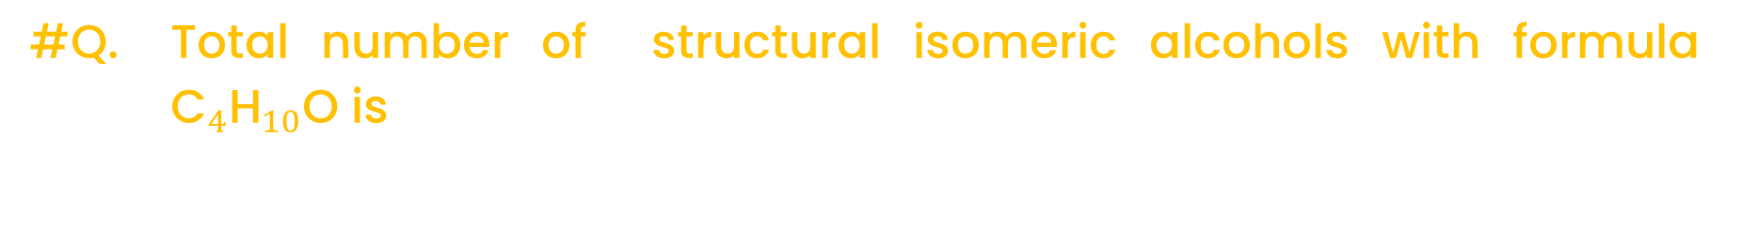
Question
#Q. Total number of structural isomeric alcohols with formula ${\text{C}}_{4}{\text{H}}_{10}$O is
[NEET PYQ]
A
2
1
3
4
B
C
D
Notes:
Ans. (D)

Slide 33
Question
#Q. How many alcohols with molecular formula C₄H₁₀O are chiral in nature?
[NCERT Exemplar]
A
1
2
3
4
B
C
D
Notes:
Ans. (A)

Slide 34
Question
#Q. Give IUPAC name of the compound given below.
CH₃—CH—CH₂—CH₂—CH—CH₃
[NCERT Exemplar]
CH
OH
A
2-Chloro-5-hydroxyhexane
2-Hydroxy-5-chlorohexane
5-Chlorohexan-2-ol
2-Chlorohexan-5-ol
B
C
D
Notes:
Ans. (C)

Slide 35
Question
#Q. How many isomers of C₅H₁₁ OH will be primary alcohols?
[1992]
A
5
4
2
3
B
C
D
Notes:
Ans. (B)

Slide 36
Topic : Structure of Functional Groups
Structure of
Methanol
Structure of
Phenol
Structure of
dimethyl ether
142 pm
96 pm
109⁰
sp³
. .
H
O
. .
H
:
141 pm
. .
O
O
C
H
. .
:
H
108.9⁰
H₃C
111.7⁰
136 pm
CH₃
H

Slide 37
The bond angle C—O—H in alcohol is slightly less than the regular tetrahedral bond angle 109°28′ . It's due to repulsion between the unshared electron pairs of oxygen .
The carbon – oxygen bond length (136pm) in phenol is slightly less than that in methanol. It’s due to
I. Partial double bond character (by delocalization)
II. sp² — carbon attached to — OH group of phenol.

Slide 38
Topic : Alcohols, Phenols and Ethers
Order of bond angle:-
Alcohol < Phenol < Ether
Order of bond length :-
Alcohol (or) Ether > Phenol
(Due to big size alkyl/aryl groups around the oxygen)

Slide 39
Topic : Methods Of Preparation Of Alcohols (R – OH)
Oxidation of Alkane.
Hydration of Alkenes.
Hydroboration – oxidation of alkenes.
Reduction or hydrogenation of Carbonyl & acid derivatives compounds.
From Grignard’s reagent (alkyl magnesium halide) (R – Mg – X).
From Amines

Slide 40
(a) From oxidation of alkane :
(i) Catalytic oxidation
(ii) Chemical oxidation

Slide 41
Hydration of Alkenes
Addition of water in presence of dil. H₂SO₄ :-
When alkene is treated with dil. H₂SO₄ it gives alcohol. This process involves formation of carbocation if there is possibility of rearrangement major product is formed after rearrangement via markovnikov’s rule.
H
H₂O/H⁺
C – C – OH
C = C

Slide 42
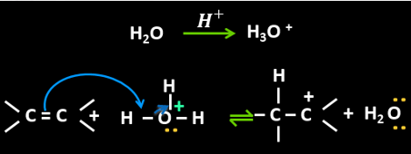
Topic : Mechanism Of Hydration Of Alkenes :
Step I :
Protonation of alkene to form carbocation by electrophilic attack of H₃O⁺

Slide 43
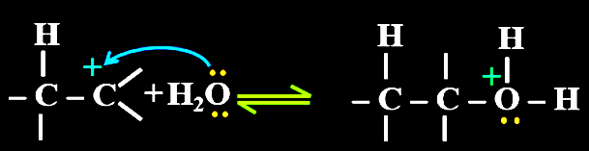
Step II :
Nucleophilic attack of water on carbocation

Slide 44
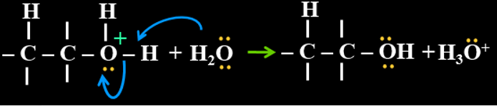
Step III :
Deprotonation to form an alcohol

Slide 45
Topic : Note
1. This method is used to prepare 2⁰ and 3⁰ alcohols.
2. This method is not useful to prepare 1⁰ alcohol except Ethanol.

Slide 46
Topic : Oxymercuration - Demercuration (OMDM)
When alkenes react with mercuric acetate (CH₃COO)₂Hg or Hg(OAc)₂, an oxymercuration product is formed, which is then reduced with NaBH₄ in a basic to yield alcohols. The first step is the addition of OH and Hg to the double bond of alkenes, known as oxymercuration, and the second is the removal of Hg, known as Demercuration.

Slide 47
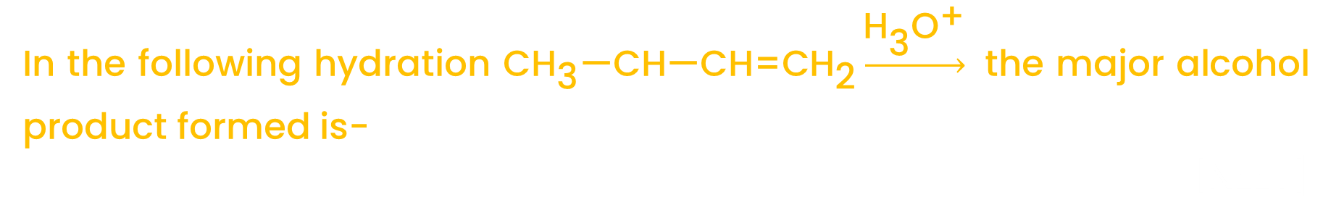


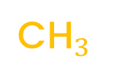
Question
$$\text{C}{\text{H}}_{3}$$
In the following hydration $\text{C}{\text{H}}_{\text{3}}\text{—}\text{C}\text{H}\text{—}\text{CH}\text{=}\text{C}{\text{H}}_{\text{2}}\underset{→}{{\text{H}}_{\text{3}}{\text{O}}^{\text{+}}}$ the major alcohol product formed is-
[NEET]
A
(CH₃)₂CHCH₂CH₂OH
(CH₃)₂CHCHOHCH₃
(CH₃)₂—CH₂—CH₃
HOCH₂CHCH₂—CH₃
B
C
$$\text{OH}$$
D
$$\text{C}{\text{H}}_{3}$$
Notes:
Ans. (C)

Slide 48
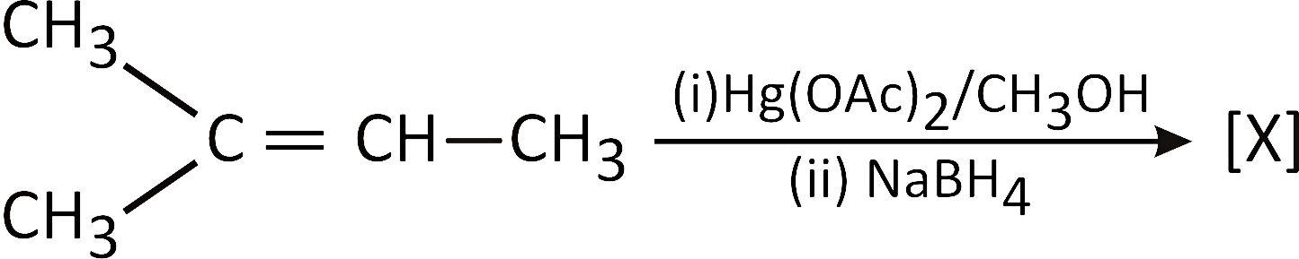
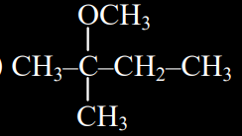
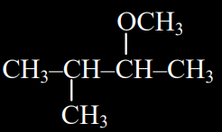
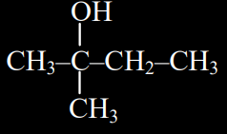
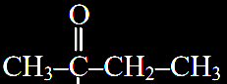
Question
#Q. In the given reaction:
[X] will be-
A
B
C
D
Notes:
Ans. (A)

Slide 49
Question
Hydration of 2-methyl but –2–ene produces.
A
1- methyl butanol
2 – methyl pentan – 2 - ol
2 – methyl butan – 2 - ol
2 – ethyl butan – 2 - ol
B
C
D
Notes:
Ans. (C)

Slide 50
Topic : Hydroboration - oxidation
Diborane (BH₃)₂ reacts with alkenes to give trialkyl boranes as addition product. This is oxidised to alcohol by hydrogen peroxide in the presence of aqueous sodium hydroxide.
6(CH₃ – CH = CH₂) + B₂H₆ 2(H₃C – CH₂ – CH₂)₃B
(Propene) Tripropylborane

Slide 51
6H₂O₂
Note :
This reaction gives AntiMarkownikoff’s product.
2(H₃C – CH₂ – CH₂)₃B
6 H₃C – CH₂ – CH₂ – OH + 2B(OH)₃
OH–
(n–Propyl alcohol
or
Propan – 1 – ol)

Slide 52
Question
B₆H₆
#Q. CH₃—CH₂—CH=CH₂ Ƶ
[2020]
H₂O. H₂O₂. OH–
A
CH₃—CH₂—CH—CH₃
CH₃—CH₂—CH₂—CHO
CH₃—CH₂—CH₂—CH₃
CH₃—CH₂—CH₂—CH₂—OH
—
OH
B
C
D
Notes:
Ans. (D)

Slide 53
Question
#Q. Can Carbocation rearrangement possible in hydroboration- oxidation & oxymercuration-demercuration reaction.
A
Yes
NO
B
Notes:
Ans. (B)

Slide 54
Question
#Q. The only primary alcohol that can be prepared by hydration of alkene is
[NCERT]
A
Propanol
Butanol
Ethanol
Ethene
B
C
D
Notes:
Ans. (C)

Slide 55
Question
#Q. The end product of which of the following reaction is not the alcohol or isomer of alcohol –
[NEET PYQ]
B₂H₆
H₂O₂
A
C₂H₄ A B
CHI₃ A B C
C₂H₄ A B C
CH₃MgBr A B
NaOH
B
Ag
dil. H₂SO₂
H₂/Pd
Δ
Hg⁺²
C
HI
aq. KOH
Conc H₂SO₄
170°C
D
CH₂O
H₂O
Notes:
Ans. (C)

Slide 56
Topic : Alkaline Hydrolysis Of Alkyl Halide
Alkaline hydrolysis of alkyl halides involve nucleophilic attack by hydroxyl ion(⁻ OH) on the carbon atom directly attached to halogen to give alcohols.

Slide 57
Question
#Q. The process of converting alkyl halides into alcohols involves______
A
Addition reaction
Substitution reaction
Dehydrohalogenation reaction
Rearrangement reaction
B
C
D
Notes:
Ans. (B)

Slide 58
Question
#Q. Hydrolysis of 1-bromopentane by an aq. NaOH gives.
[NCERT]
A
1 - propanol
2 - propanol
1 - pentanol
2 - pentanol
B
C
D
Notes:
Ans. (C)

Slide 59
Topic : By Reduction Reaction
(i) Bouveault-Blanc reduction :-
When carbonyl or ester are treated with sodium in presence of ethanol to give alcohol.

Slide 60
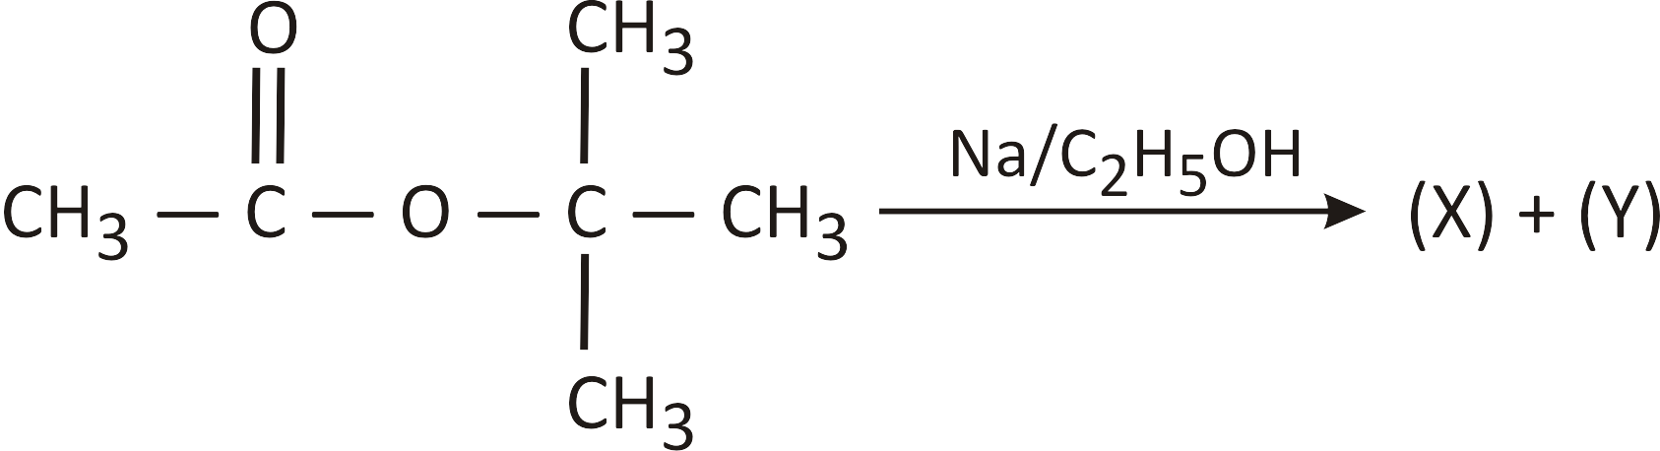
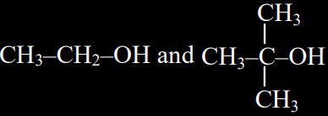
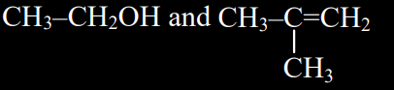
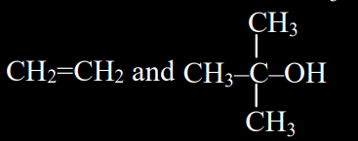
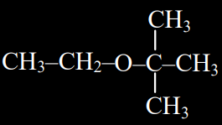
Question
In the given reaction
[X] and [Y] respectively will be
A
B
C
D
Notes:
Ans. (A)

Slide 61
Question
#Q. Which of the following reactions is not called Bouveault-Blanc reduction :
Na + ethanol
A
R — CHO R — CH₂OH
R — CO — R’ R — CHOH — R’
R — COOH R — CH₂OH
RCOOR’ R — CH₂OH + R’OH
B
Na + ethanol
C
LiAlH₄
D
Na + ethanol
Notes:
Ans. (C)

Slide 62
Topic : By Reduction Reaction
(ii) Reduction by metallic hydride :-
Carbonyl, acid and acid derivatives except amide are reduced in presence of LiAlH₄ to give alcohol while nitro, cyano, isocyano & amide are reduced into amine but it cannot reduce olefinic bond .
NaBH₄ is weak reducing agent it can reduce only acid halide and carbonyl into alcohol.

Slide 63
Question
#Q. Consider the following transformations.
CH₃CH=CHCHO A B
The final product (B) is-
[NEET PYQ]
LiAlH₄
H₂O
Et₂O
A
CH₃CH=CHCH₂OH
CH₃CH₂CH₂CH₂OH
CH₃CH=CHCH₃
CH₃CH₂CH₂CH₃
B
C
D
Notes:
Ans. (A)

Slide 64
(iii) Meerwein - Ponndorf - Verley reduction (MPV reduction):-
When carbonyl are reduced with isopropyl alcohol in presence of aluminium isopropoxide to give alcohol with formation of acetone. If acetone is not removed reaction go in reverse direction.
If Aluminium tertiary butoxide is used as catalyst then reaction is called Oppenauer oxidation.

Slide 65
Question
#Q. The reagent used for converting ethanoic acid to ethanol is.
A
LiAlH₄
BH₃
PCl₅
K₂Cr₂O₇/H⁺
B
C
D
Notes:
Ans. (A)

Slide 66
Question
#Q. Esterification of carboxylic acid followed by reduction with lithium aluminium hydride yields
A
Esters
Ethers
Alcohols
Aldehyde
B
C
D
Notes:
Ans. (C)

Slide 67
Topic : From Amines
When primary aliphatic amine react with Nitrous acid to give alcohol . This reaction involve carbocation intermediate if there is possibility of rearrangement major product is formed after rearrangement.

Slide 68
Topic : From Grignard Reagent
Alcohols are produced by the reaction of Grignard reagents with aldehydes and ketones. The first step of the reaction is the nucleophilic addition of Grignard reagent to the carbonyl group to form an adduct. Hydrolysis of the adduct yields an alcohol

Slide 69
Question
#Q. What is the IUPAC name of the organic compound formed in the following chemical reaction?
Acetone P
(i) C₂H₅MgBr, dry Ether
(ii) H₂O/H⁺
Notes:
Ans. 2-methyl butan-2-ol

Slide 70
Question
CH₃NH₂ + HNO₂ $→$ Products
The products in the above reaction are-
A
CH₃OH, CH₃–NO₂
CH₃–O–CH₃, CH₃–O–N=O
CH₃–OH, CH₃–O–N=O
CH₃CH₂OH, CH₃–NO₂
B
C
D
Notes:
Ans. (A)

Slide 71
Question
Increasing order of acid strength among p-methoxyphenol,
p-methylphenol and p-nitrophenol is
[1993]
A
p-Nitrophenol, p-Methoxyphenol, p-Methylphenol
p-Methylphenol, p-Methoxyphenol, p-Nitrophenol
p-Nitrophenol, p-Methylphenol, p-Mehoxyphenol.
p-Methoxyphenol, p-Methylphenol, p-Nitrophenol
B
C
D
Notes:
Ans. (D)

Slide 72
Question
X + Y $→$ 3-ethylpentane-3-ol, the reactants X and Y respectively are -
A
CH₃CH₂MgBr + CH₃COCH₂CH₃
CH₃MgBr + CH₃CH₂CH₂COCH₂CH₃
CH₃CH₂MgBr + CH₃CH₂COCH₂CH₃
CH₃CH₂CH₂MgBr + CH₃COCH₂CH₃
B
C
D
Notes:
Ans. (C)

Slide 73
Question
#Q. Alcohols can be obtained from carbonyl compounds by
[NCERT]
A
Oxidation
Reduction
Hydration
Dehydration
B
C
D
Notes:
Ans. (B)

Slide 74
Question
#Q. Two organic compounds A and B react with sodium metal and release H₂ gas. A and B react with each other to give ethyl acetate. The A and B are
A
CH₃COOH and C₂H₅OH
HCOOH and C₂H₅OH
CH₃COOH and CH₃OH
CH₃COOH and HCOOH
B
C
D
Notes:
Ans. (A)

Slide 75
Question
#Q. The stablest among the following is
[1994]
A
CH₃CH(OH)₂
ClCH₂CH(OH)₂
(CH₃)₂C(OH)₂
CCl₃CH(OH)₂
B
C
D
Notes:
Ans. (D)

Slide 76
Question
#Q. What is formed when a primary alcohol undergoes catalytic dehydrogenation?
[1993]
A
Aldehyde
Ketone
Alkene
Acid
B
C
D
Notes:
Ans. (D)

Slide 77
Question
#Q. Propene, CH₃CH=CH₂ can be converted into 1-propanol by oxidation. Indicate which set of reagents amongst the following is ideal to effect the above conversion?
[1989]
A
KMnO₄ (alkaline)
Osmium tetraoxide (OsO₄/CH₂Cl₂)
B₂H₆ and alk. H₂O₂
O₃/Zn
B
C
D
Notes:
Ans. (C)

Slide 78
Question
#Q. H₂COH.CH₂OH on heating with periodic acid gives:
[2009]
A
2HCOOH
2 C = O
2CO₂
CHO
B
CHO
H
C
H
D
Notes:
Ans. (C)

Slide 79
Question
#Q. Consider the following reaction,
ethanol X Y Z;
the product Z is:
[2009]
PBr₃
alc. KOH
(i) H₂SO₄ room temperature
(ii) H₂O, heat
A
CH₃CH—O—CH₂—CH₃
CH₃—CH₂—O—SO₃H
CH₃CH₂OH
CH₂=CH₂
B
C
D
Notes:
Ans. (C)

Slide 80
Question
#Q. The process of converting alkyl halides into alcohols involves ________.
[NCERT Exemplar]
A
Addition reaction
Substitution reaction
Dehydrohalogenation reaction
Rearrangement reaction
B
C
D
Notes:
Ans. (A)

Slide 81
Topic : Methanol
1. From Water Gas
Methanol is a colourless liquid, boils at 337 K and highly poisonous in nature.
Methanol is used as a solvent in paints, varnishes.
2. From destructive distillation of wood
Cr₂O₃ – ZnO
CO + 2H₂
H₃C – OH
573−673K, 200−300 Pressure
(Methanol)

Slide 82
Uses of Methanol
Industrial solvent for oils , fats, gums etc.
For dry cleaning & preparation of perfumes.
To prepare chloromethane, dimethyl sulphate and formaldehyde etc.

Slide 83
Topic : Ethanol
Ethanol, C₂H₅OH, is obtained commercially by fermentation.
Ethanol is a colourless liquid with boiling point 351 K.
Ethanol is used as a solvent in paint industry and in the preparation of a number of carbon compounds.
Invertase
C₁₂H₂₂O₁₁ + H₂O C₆H₁₂O₆ + C₆H₁₂O₆
Glucose
Fructose
Zymase
C₆H₁₂O₆ 2C₂H₅OH + 2CO₂

Slide 84
Topic : Uses of Ethanol
As a solvent for dyes, oils, perfumes, cosmetics and drugs.
Mixture of 10 – 20% Ethanol with petrol is used as motor fuel.
As an alcoholic beverages.
Effective topical antiseptic.
Used to prepare chloroform, iodoform, acetic acid etc.

Slide 85
Topic : Note
Rectified spirit = 95.6% ethyl alcohol + 4.4% water ( azeotropic mixture).
Power alcohol = 20% Absolute alcohol + 80% petrol.
Absolute alcohol = ethyl alcohol containing not more than 1% water
(99% Pure ethyl alcohol )

Slide 86
Question
#Q. Following is used as an “antifreezing agent”.
[NEET PYQ]
A
Methanol
Glycol
Propanol
None of these
B
C
D
Notes:
Ans. (B)

Slide 87
Question
#Q. 95.6% ethyl alcohol and 4.4% water is
[NEET PYQ]
A
Power alcohol
Rectified spirit
Absolute alcohol
None of these
B
C
D
Notes:
Ans. (B)

Slide 88
Question
#Q. Methanol is industrially prepared by
[1992]
A
Oxidation of CH₄ by steam at 900°C
Reduction of HCHO using LiAIH₄
Reaction HCHO with a solution of NaOH
Reduction of CO using H₂ and ZnO—Cr₂O₃
B
C
D
Notes:
Ans. (D)

Slide 89
Question
#Q. Match the following
The correct match is
A B C D A B C D
 | List-I |  | List-II
A. | Glycerol | I. | Denatured alcohol
B. | Ethylene glycol | II. | Absolute ethanol + petrol
C. | Methylated spirit | III. | Coolant
D. | Power alcohol | IV. | Moisturiser
A
IV III II I
B
IV III I II
C
III IV II I
D
II III IV I
Notes:
Ans. (B)

Slide 90


