Slide 1

CONTACT NO : 8881390557
Subject Name - BOTANY
Class - 11th NEET
Chapter Name –
Anatomy of Flowering Plant
By-Faculty name
PPT No.- 01/01

Slide 2

PPT CONTENT
Sr. No. | TOPICS
1. | Introduction
2. | Tissue
3. | Types Of Tissue
4. | Meristematic Tissue
5. | Permanent Tissue
6. | Tissue System
7. | Anatomy Of Root, Stem And Leaf

Slide 3
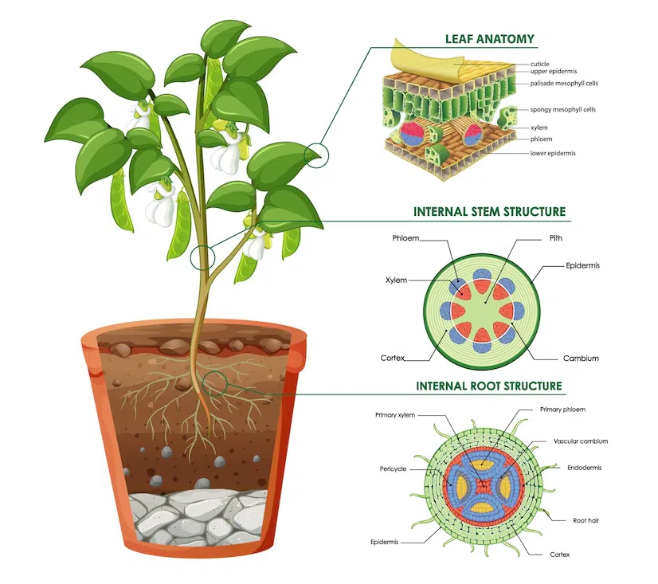
INTRODUCTION
Anatomy: Study of internal structure and functional organization of plants.
N.Grew (Nehemiah Grew) is known as father of plant anatomy.
K.A. Chaudhary is known as father of Indian plant anatomy.

Slide 4
Topic : Tissue
A group of cells having common origin and usually performing a common function.
On the basis of capacity to divide, tissue can be classified into two groups:
Meristematic tissue (undifferentiated)
Permanent tissue (differentiated)

Slide 5
Topic : Meristematic tissue
Growth in plants is largely restricted to specialized regions of active cell division called meristems.
Meristem is derived from Greek word meristos: devided.

Slide 6
Topic : Classification of Meristematic tissue
Meristematic tissue
Based on origin and development
Based on location
Primary meristematic tissue
Secondary meristematic tissue
Apical meristem
Intercalary meristem
Lateral meristem

Slide 7
Primary meristem | Secondary meristem

Slide 8
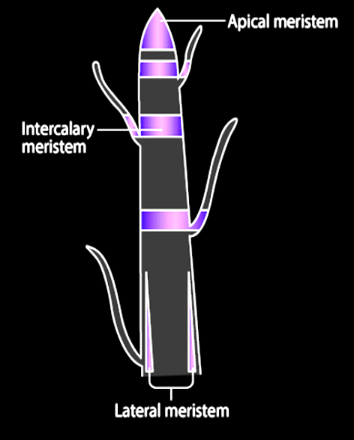
01
Apical meristem
02
Intercalary meristem
03
Lateral meristem

Slide 9
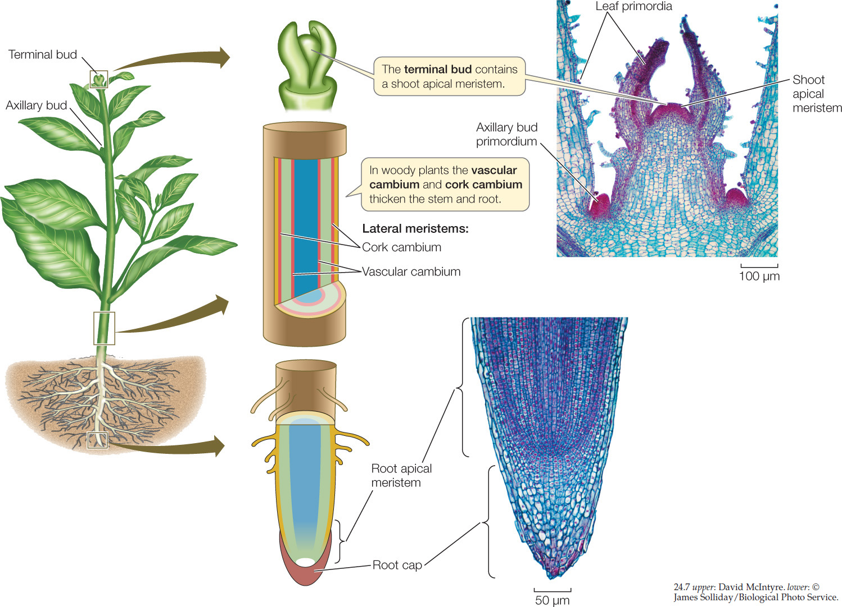
01
Apical meristem

Slide 10
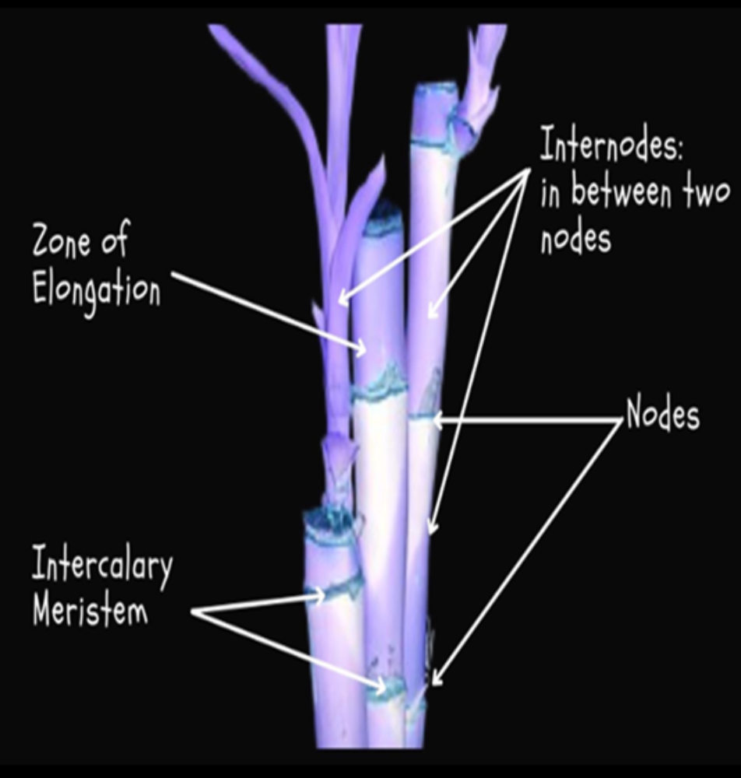
02
Intercalary meristem

Slide 11
03
Lateral meristem
Primary lateral
Secondary lateral

Slide 12
Question
Which of the following is not primary meristem?
A
Apical meristem
Meristem on leaf
Cork cambium
Both (B) and (C)
B
C
D
Notes:
Ans. (C)

Slide 13
Question
From following which is not feature of meristematic cell-:
A
Large nucleus
Lignified cell wall
Cell wall primary
Dense cytoplasm
B
C
D
Notes:
Ans. (B)

Slide 14
Question
Meristem derived from permanent cells are-
A
Always cork cambium
For secondary growth
For both primary and secondary growth
Always form secondary xylem
B
C
D
Notes:
Ans. (B)

Slide 15
Question
Mark the incorrect statement-
A
Not all secondary meristem is lateral
All primary growth occur by primary meristem
Vascular cambium is more active on the inner side in stem
Bulliform cell become flaccid in night and turgid during day
B
C
D
Notes:
Ans. (A)

Slide 16
Question
Epidermis, Endodermis, Primary xylem, primary phloem - how many are product of differentiation-
A
Three
Four
Five
Two
B
C
D
Notes:
Ans. (B)

Slide 17
Question
Which one of the following is not a lateral meristem?
[2010]
A
Intrafascicular cambium
Interfascicular cambium
Phellogen
Intercalary meristem
B
C
D
Notes:
Ans. (D)

Slide 18
Question
The length of different internodes in a culm of sugarcane is variable because of
[2008]
A
Size of leaf lamina at the node below each internode
Intercalary meristem
Shoot apical meristem
Position of axillary buds
B
C
D
Notes:
Ans. (A)

Slide 19
Question
Axillary bud and terminal bud derived from the activity of
[2002]
A
Lateral meristem
Intercalary meristem
Apical meristem
Parenchyma
B
C
D
Notes:
Ans. (C)

Slide 20
Topic : Permanent tissues
Simple permanent tissue
Complex permanent tissue
Parenchyma
Xylem
Collenchyma
Phloem
Sclerenchyma

Slide 21
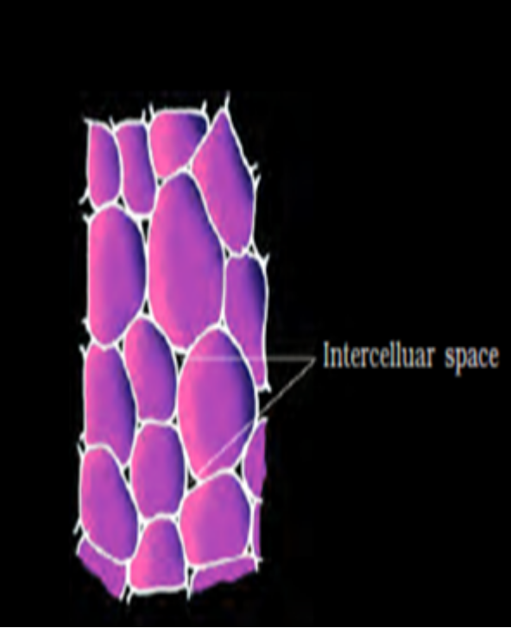
Topic : Simple permanent tissue
Parenchyma
Parenchyma forms the major component within organs.
Isodiametric.
Shape- spherical, oval, round, polygonal or elongated.
Cell wall- thin and cellulosic.
They may either be closely packed or have small intercellular spaces.
Functions - photosynthesis, storage, secretion.

Slide 22
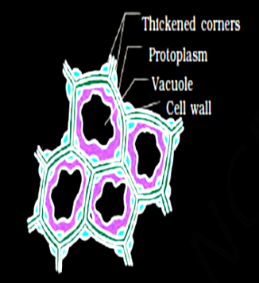
Collenchyma
Location- Layers below the epidermis in most dicots.
Either homogeneous layer or in patches.
Cells are thickened at the corners deposition of cellulose, hemicellulose and pectin.
Shape - oval, spherical or polygonal
Function –
Mechanical support to the growing parts of the plant i.e. young stem and petiole of a leaf.
Food assimilation when chloroplast is present.

Slide 23
Sclerenchyma
They are long, narrow cells with thick and lignified cell walls
They are dead and without protoplasts.
On the basis of variation is form, structure, origin and development they of two types.

Slide 24
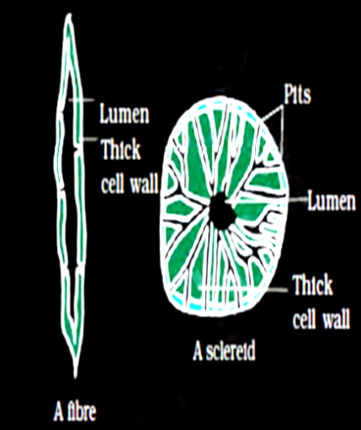
Fibres – Thick walled elongated & pointed cells
Sclereids – Spherical, oval, cylindrical, highly thickened call walls with narrow cavities (lumen)
Function – Provides mechanical support to organs
Ex. Found in fruit walls of nuts, pulp of fruits like guava, pear & Sapota, seed coats of legumes and leaves of tea

Slide 25
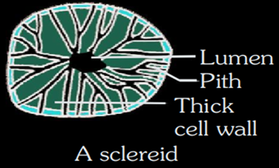
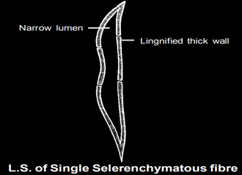
Sclerenchyma
Types
Sclereids
Sclerenchymatous fibres

Slide 26
Question
Parenchyma absent in-
A
Conjunctive tissue
Pith
Stem hypodermis
Leaf epidermis
B
C
D
Notes:
Ans. (C)

Slide 27
Question
Which of the following is not present in roots-
A
Collenchyma
Lenticels
Cork layer
Parenchyma
B
C
D
Notes:
Ans. (C)

Slide 28
Question
Consider the following-
(a) All collenchyma cells are non-photosynthetic
(b) Unequal size vascular bundle present in both monocot and dicot
How many are correct-
A
Only A
Only B
Both correct
Both wrong
B
C
D
Notes:
Ans. (B)

Slide 29
Question
Consider the following statement-
(a) Collenchyma is present always as homogenous layer
(b) some sclerenchyma is cylindrical in shape
How many correct-
A
Only A
Only B
Both correct
Both wrong
B
C
D
Notes:
Ans. (C)

Slide 30
Question
Which of the following is not true about ‘Sclereids’ ?
A
These are groups of living cells.
These are found in nut shells, guava pulp, pear.
These are also called stone cells.
These are form of sclerenchyma with fibers.
B
C
D
Notes:
Ans. (A)

Slide 31
Question
Collenchyma occurs in the stem and petioles of
A
Xerophytes
Monocots
Dicot herbs
Hydrophytes
B
C
D
Notes:
Ans. (B)

Slide 32
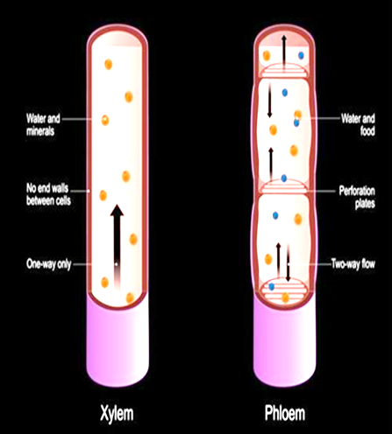
Topic : Complex permanent tissue
The complex tissues are made of more than one type of cells and these work together as a unit.
They are also known as conducting or vascular tissues.
Xylem and phloem constitute the complex tissues in plants.

Slide 33
Primary xylem
Xylem
On The Basis Of Origin
Secondary xylem

Slide 34
Xylem
Composed of four elements:
Tracheids
Vessels
Xylem fibres
Xylem parenchyma

Slide 35
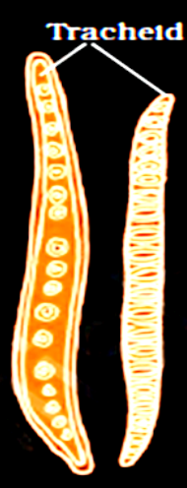
Tracheids
Tracheids are elongated or tube like cells with thick and lignified walls and tapering ends.
These are dead and are without protoplasm.
The inner layers of the cell walls have thickenings which vary in form.
In flowering plants, tracheids and vessels are the main water transporting elements.

Slide 36
Question
The chief water conducting elements of xylem in gymnosperms are
A
Vessels
Fibres
Transfusion tissue
Tracheids
B
C
D
Notes:
Ans. (D)

Slide 37
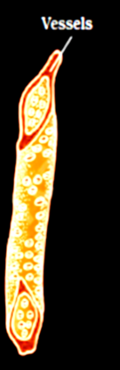
Topic : Vessels
A long cylindrical tube-like structure made up of many cells called vessel members, with lignified walls and a large central cavity.
The cells are also devoid of protoplasm and interconnected through perforations in their common walls.
The presence of vessels is a characteristic feature of angiosperms.
It is absent in gymnosperms.

Slide 38
Question
Pits are present in-
A
Vessels
Tracheids
Fiber
All
B
C
D
Notes:
Ans. (D)

Slide 39
Topic : Xylem Fibres
Xylem fibres have highly thickened walls and obliterated central lumens.
These may either be septate or aseptate.
It provides strength to the tracheids and vessels.

Slide 40
Topic : Xylem Parenchyma
Xylem parenchyma cells are living and thin-walled, and their cell walls are made up of cellulose.
They store food materials in the form of starch or fat, and other substances like tannins.
The radial conduction of water takes place by the ray parenchymatous cells.

Slide 41
Topic : Complex Permanent Tissue
Primary Phloem
Phloem
On The Basis Of Origin
Secondary Phloem

Slide 42
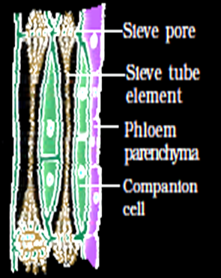
Topic : Phloem
Phloem transports food materials, usually from leaves to other parts of the plant.
Phloem in angiosperms is composed of sieve tube elements, companion cells, phloem parenchyma and phloem fibres.
Gymnosperms have albuminous cells and sieve cells.
They lack sieve tubes and companion cells.

Slide 43
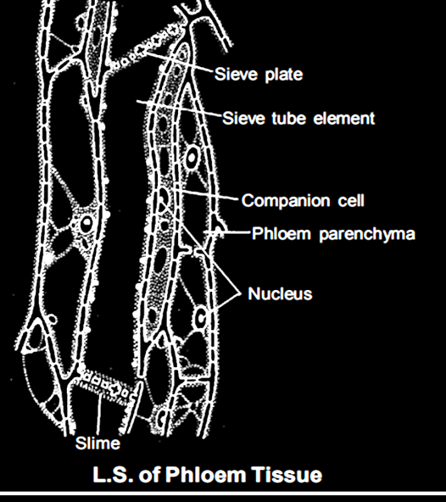
Composed of Four Elements:
Sieve Tubes
Companion Cells
Phloem Fibres
Phloem Parenchyma

Slide 44
Topic : Sieve Tubes
Long, tube-like structures, arranged longitudinally and are associated with the companion cells.
Perforated end walls in a sieve-like manner that form the sieve plates.
A mature sieve element - a peripheral cytoplasm and a large vacuole but lacks a nucleus.
The functions of sieve tubes are controlled by the nucleus of companion cells.

Slide 45
Topic : Companion Cells
These are specialized parenchymatous cells in close association with sieve tube elements.
The sieve tube elements and companion cells are connected by pit fields present between their common longitudinal walls.
The companion cells help in maintaining the pressure gradient in the sieve tubes.

Slide 46
Question
Perforations in wall and peripheral cytoplasm is feature of-
A
Vessels
Sieve tube
Companion cell
Tracheids
B
C
D
Notes:
Ans. (B)

Slide 47
Topic : Phloem Parenchyma
Phloem parenchyma is made up of elongated, tapering cylindrical cells which have dense cytoplasm and nucleus.
The cell wall is composed of cellulose and has pits through which
plasmodesmata connections exist between the cells.
The phloem parenchyma stores food material and other substances like resins, latex and mucilage.
It is absent in most of the monocotyledons.

Slide 48
Topic : Phloem fibers
Phloem fibres (bast fibres) are made up of sclerenchymatous cells. These are generally absent in the primary phloem but are found in the secondary phloem.
These are much elongated, unbranched and have pointed, needle like apices.
The cell wall of phloem fibres is quite thick.
At maturity, these fibres lose their protoplasm and become dead.
Phloem fibres of jute, flax and hemp are used commercially.

Slide 49
Question
Inner to the layer of secondary phloem which can be present
A
Primary phloem
Secondary phloem
Both 1 and 4
Vascular cambium
B
C
D
Notes:
Ans. (D)

Slide 50
Question
Phloem fiber is present in.
A
Dicot stem
Dicot leaf
Monocot Root
All
B
C
D
Notes:
Ans. (A)

Slide 51
Question
Phloem fibre is present in
A
Protophloem
Meta phloem
Secondary phloem
All
B
C
D
Notes:
Ans. (D)

Slide 52
Question
Tracheids differ from other tracheary elements in
[2014]
A
Having Casparian strips
Being imperforate
Lacking nucleus
Being lignified
B
C
D
Notes:
Ans. (B)

Slide 53
Question
Gymnosperms are also called soft wood spermatophytes because they lack
[2012]
A
Cambium
Phloem fibres
Thick-walled tracheids
Xylem fibres
B
C
D
Notes:
Ans. (D)

Slide 54
Question
Companion cells are closely associated with
[2012]
A
Sieve elements
Vessel elements
Trichomes
Guard cells
B
C
D
Notes:
Ans. (A)

Slide 55
Question
A common structural feature of vessel elements and sieve tube elements is
[2006]
A
Enucleate condition
Thick secondary walls
Pores on lateral walls
Presence of P-protein
B
C
D
Notes:
Ans. (A)

Slide 56
Topic : Tissues system
1. Epidermal tissue system
2. Ground tissue system
3. Vascular tissue system

Slide 57
1. Epidermal tissue system

Slide 58
2. Ground tissue system

Slide 59
3. Vasscular tissue system

Slide 60
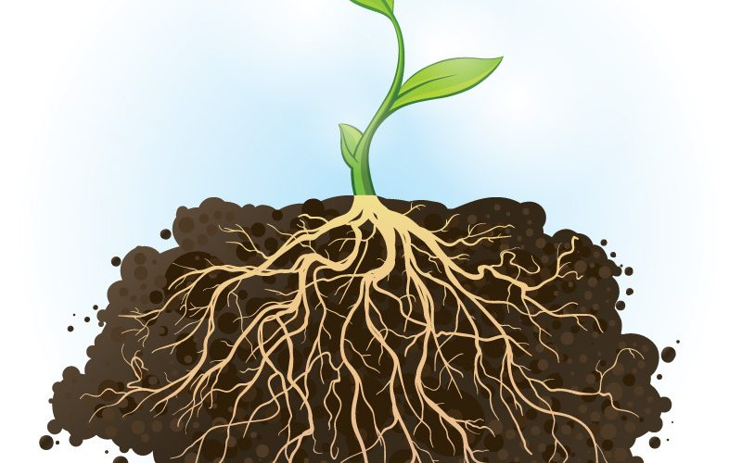
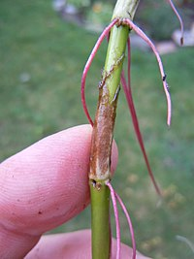
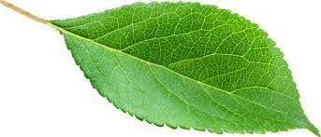
Topic : Anatomy of monocots and dicots
The anatomy of plant body can be understood by the study of transverse section of its organs i.e. root, stem, and leaf.

Slide 61
Topic : Dicotyledonous Root
The internal tissue organization of dicot root:
Epiblema -
Cortex -
Casparian strips -

Slide 62
Pericycle
Vascular bundles
Pith

Slide 63
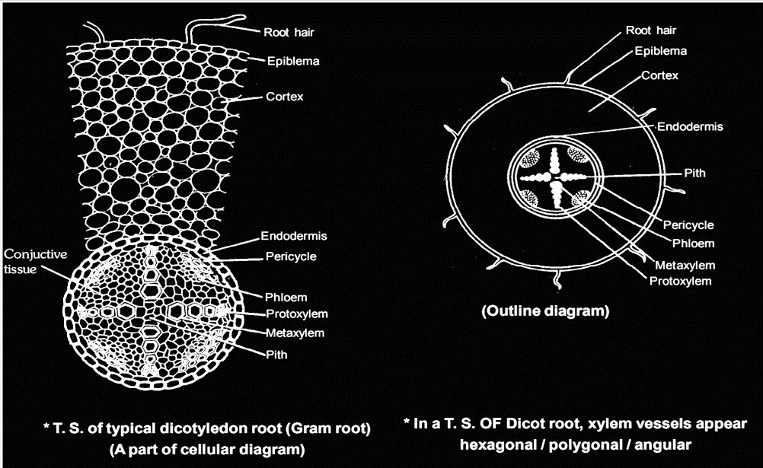

Slide 64
Topic : Monocotyledonous Root
The anatomy of the monocot root is similar to the dicot root in many respects.
It has epidermis, cortex, endodermis, pericycle, vascular bundles and pith.
As compared to the dicot root which have fewer xylem bundles, there are usually more than six (polyarch) xylem bundles in the monocot root.
Pith is large and well developed.
Monocotyledonous roots do not undergo any secondary growth.

Slide 65
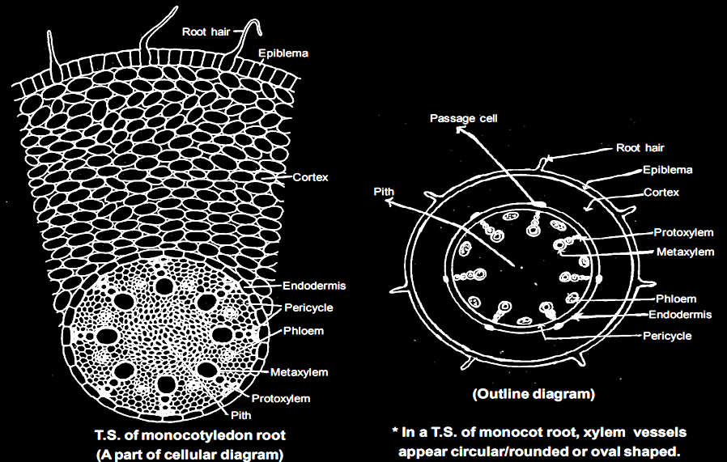

Slide 66
Question
Which is incorrect about vascular bundle in monocots-
A
Unequal
Radial
Conjoint
Open
B
C
D
Notes:
Ans. (D)

Slide 67
Topic : Dicotyledonous Stem
The internal tissue organization of dicot stem:
Epidermis
Cortex
Hypodermis
Cortical layer
Endodermis

Slide 68
Pericycle
Vascular bundles
Pith
Medullary rays

Slide 69
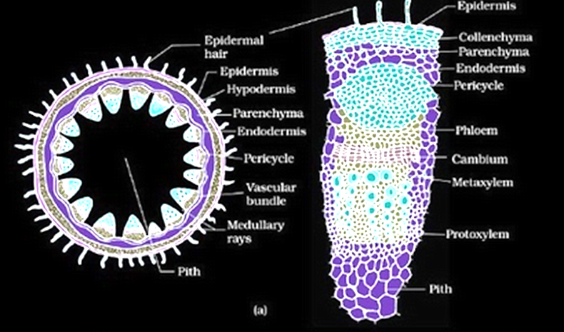

Slide 70
Question
Dicot stem lack-
Endarch vascular bundle
Collenchyma
Starch sheath
Bundle sheath cell
A
B
C
D
Notes:
Ans. (B)

Slide 71
Question
Hypodermis in dicot stem is-
Single layer
Many layer
Parenchyma
Inner to cortex
A
B
C
D
Notes:
Ans. (A)

Slide 72
Topic : Monotyledonous Stem
The monocot stem has a sclerenchymatous hypodermis, a large number of scattered vascular bundles, each surrounded by a sclerenchymatous bundle sheath, and a large, conspicuous parenchymatous ground tissue.
Vascular bundles are conjoint and closed.
Peripheral vascular bundles are generally smaller than the centrally located ones.
The phloem parenchyma is absent, and water-containing cavities are present within the vascular bundles.

Slide 73
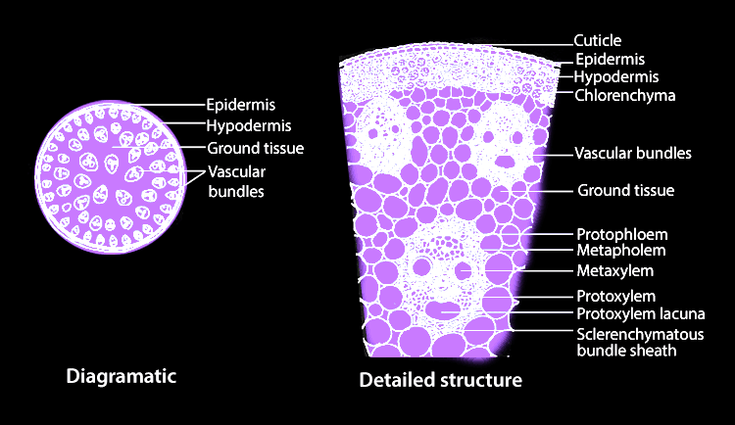

Slide 74
Question
Which is absent in monocot stem-
Unequal size vascular bundle
Water containing cavities
Differentiated ground tissue
Fibre containing hypodermis
A
B
C
D
Notes:
Ans. (C)

Slide 75
Topic : Dicotyledonous Leaf
The vertical section of a dorsiventral leaf through the lamina shows three main parts, namely, epidermis, mesophyll and vascular system.
Epidermis
Mesophyll

Slide 76
Mesophyll has two types of cells – the palisade parenchyma and the spongy parenchyma.
Palisade parenchyma
Spongy parenchyma
Vascular bundles
Bundle sheath cells

Slide 77
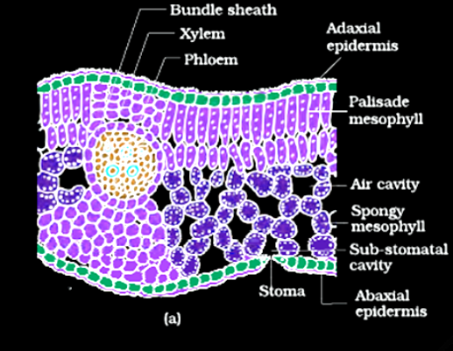

Slide 78
Topic : Monotyledonous Leaf
In an isobilateral leaf, the stomata are present on both the surfaces of the epidermis and the mesophyll is not differentiated into palisade and spongy parenchyma.
Bulliform cells
Parallel venation

Slide 79
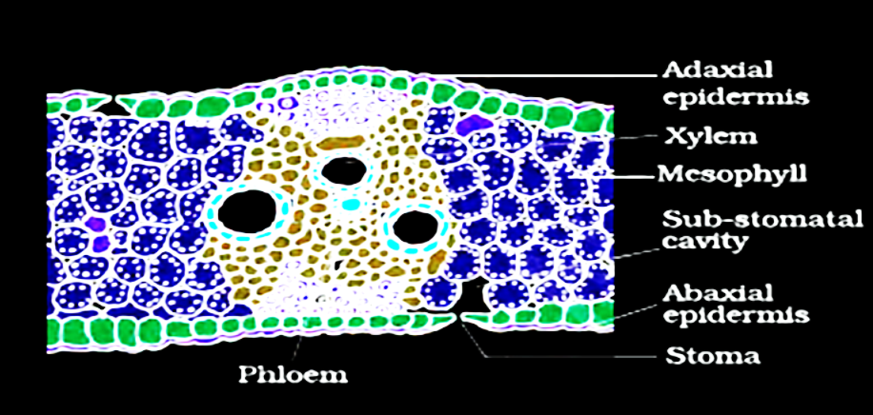

Slide 80
Question
Mark the incorrect
A
In dicot leaf Xylem is present toward abaxial surface
In bulliform cell chloroplast absent
Hypodermis in dicot stem is multilayered
Sap wood is lighter in colour
B
C
D
Notes:
Ans. (B)

Slide 81
Question
If a transverse section of plant have conjoint unequal size bundle than it is-
A
Dicot stem and monocot root
Dicot stem and monocot leaf
Monocot leaf and dicot root
Dicot leaf and monocot stem
B
C
D
Notes:
Ans. (D)

Slide 82
Question
Casparian strips occur in
[NEET 2018]
A
Epidermis
Pericycle
Cortex
Endodermis.
B
C
D
Notes:
Ans. (D)

Slide 83
Question
The transverse section of a plant shows following anatomical features:
(i) Large number of scattered vascular bundles surrounded by bundle sheath
(ii) Large conspicuous parenchymatous ground tissue
(iii) vascular bundles conjoint and closed
(iv) phloem parenchyma absent
Identify the category of plant and its part.
[NEET 2020]
A
Monocotyledonous stem
Monocotyledonous root
Dicotyledonous stem
Dicotyledonous root
B
C
D
Notes:
Ans. (A)

Slide 84


