Slide 1

Subject Name - Physics
Class - 12th NEET
Chapter Name –
Electromagnetic Induction
PPT No.- 01/02

Slide 2
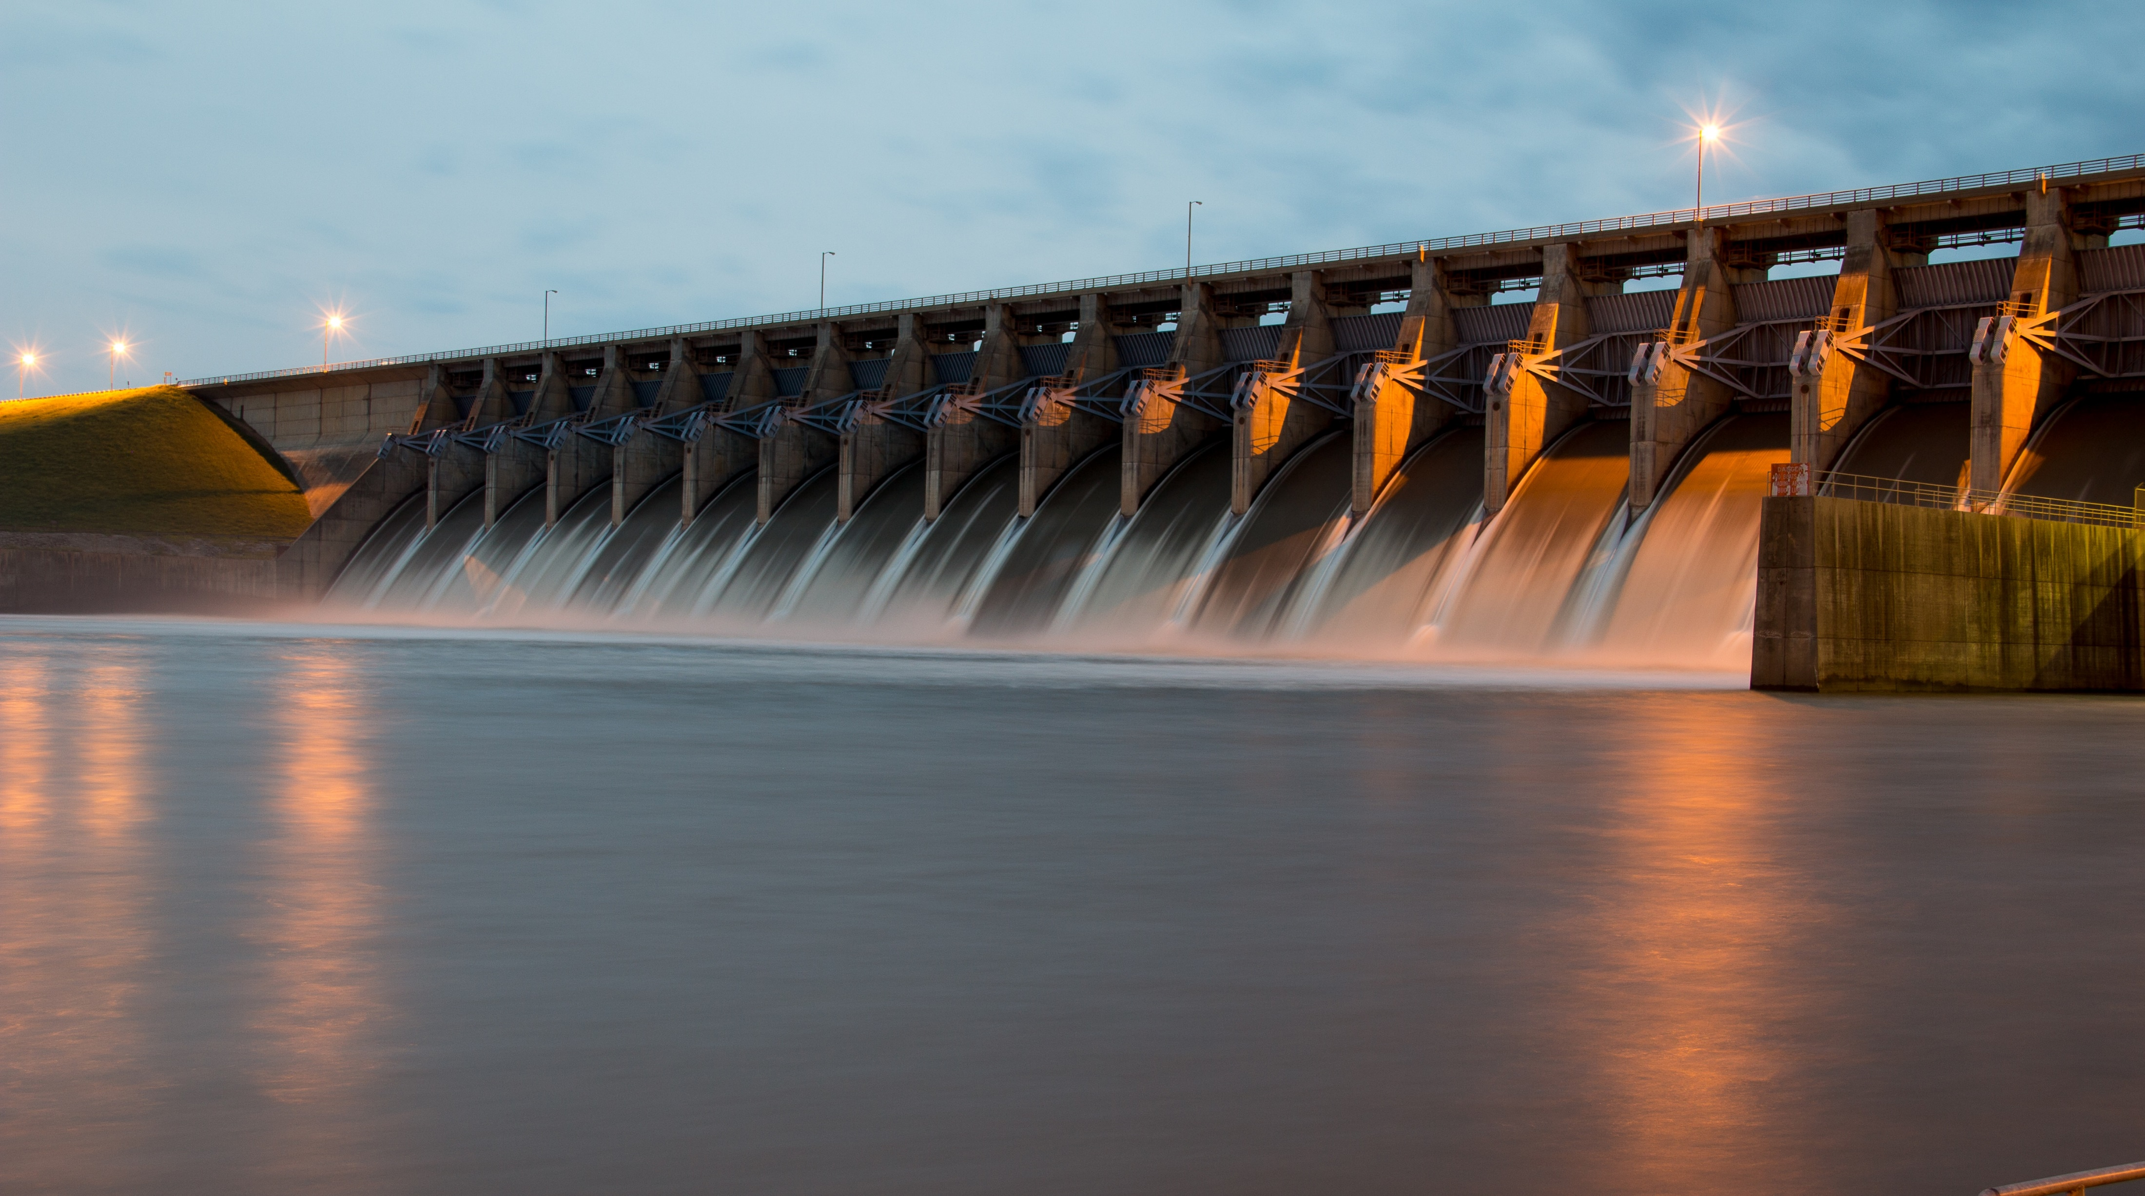

INTRODUCTION
How does they generate electricity

Slide 3
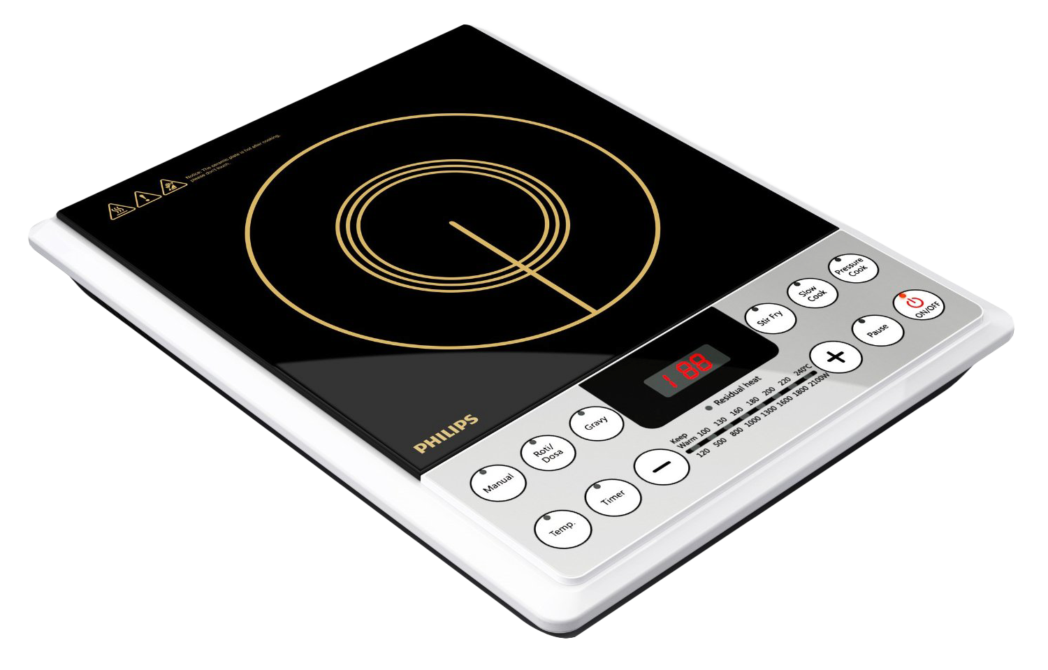
How do they work

Slide 4
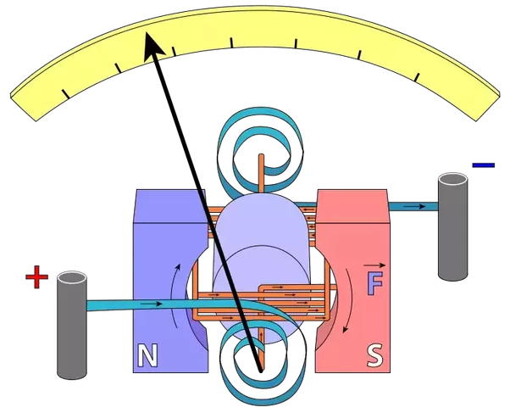
Why it stop not keep oscillating like pendulum

Slide 5
Previous Year Exam Analysis
Numbers of questions
Years

Slide 6
PPT CONTENT
Sr. No. | TOPICS
1. | Magnetic Flux
2. | Faraday’s Law
3. | Lenz’s Law
4. | Motional emf
5. | Rotational emf
6. | Eddy Current
7. | Induced Electric Field

Slide 7
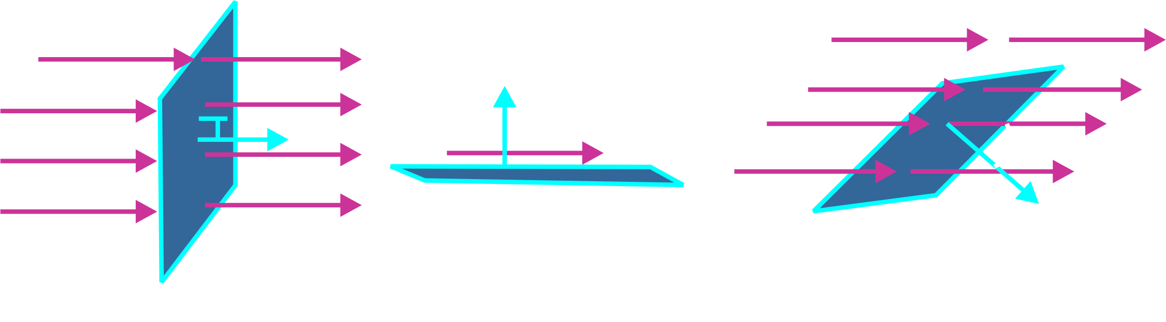

Topic : Magnetic flux
When magnetic flux passing through a loop changes with time or magnetic lines of force are cut by a conducting wire then an emf is produced in the loop or in that wire. This emf is called induced emf. If the circuit is closed, then the current will be called induced current.
Magnetic flux = $\int{\vec{B}.d\vec{s}}$

Slide 8
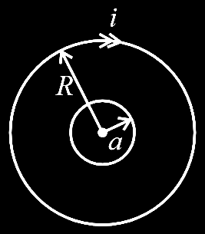
Question
Find the magnetic flux through area πa² of small circle. (a << R)
Notes:
Ans : $\frac{μ_{0}πa^{2}i}{\text{2}\text{R}}$

Slide 9
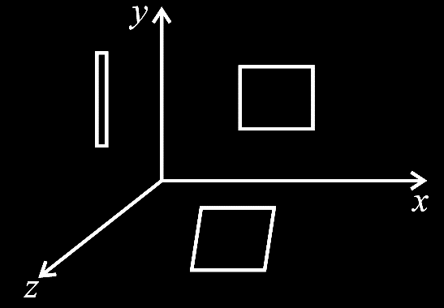
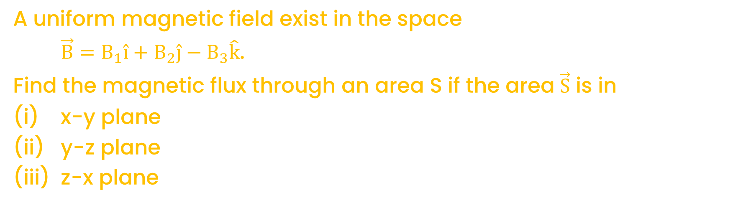
Question
A uniform magnetic field exist in the space
$\vec{B}=B_{1}\hat{i}+B_{2}\hat{j}−B_{3}\hat{k}$.
Find the magnetic flux through an area S if the area $\vec{S}$ is in
(i) x-y plane
(ii) y-z plane
(iii) z-x plane
Notes:
Ans : (i) φ₁ = –B₃S, (ii) φ₂ = B₁S, (iii) φ₃ = B₂S

Slide 10
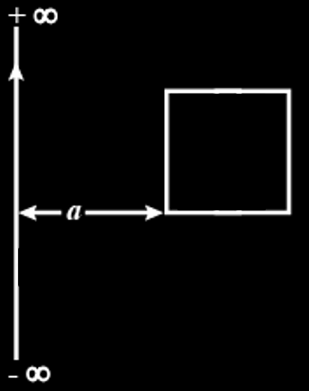
Question
Figure shows a long straight wire carrying current I and a square conducting wire loop of side l, at a distance ‘a’ from current wire. Both the current wire and loop are in the plane of paper. Find the flux of magnetic field of current wire, passing through the loop.
Notes:
Ans : $\frac{μ_{0}iℓ}{2π}\ln\left(\frac{a+ℓ}{a}\right)$

Slide 11
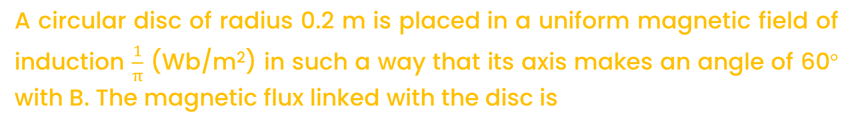
Question
A circular disc of radius 0.2 m is placed in a uniform magnetic field of induction $\frac{1}{π}$ (Wb/m²) in such a way that its axis makes an angle of 60° with B. The magnetic flux linked with the disc is
[CBSE AIPMT 2008]
A
0.02 Wb
0.06 Wb
0.08 Wb
0.01 Wb
B
C
D
Notes:
Ans : A

Slide 12
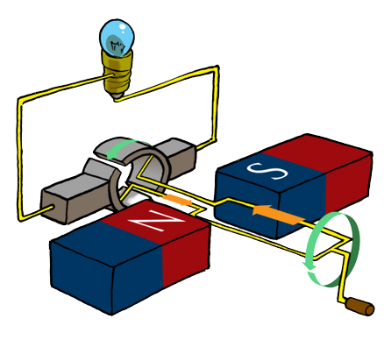

Topic : Faraday’s Laws of Electromagnetic Induction
The magnitude of induced emf is equal to the rate of change of flux w.r.t. time in case of loop. In case of a wire, it is equal to the rate at which magnetic lines of force are cut by a wire
$$E=–\frac{dϕ}{dt}$$
(–) sign indicates that the emf will be induced in such a way that it will oppose the change of flux. SI unit of magnetic flux = Weber.

Slide 13
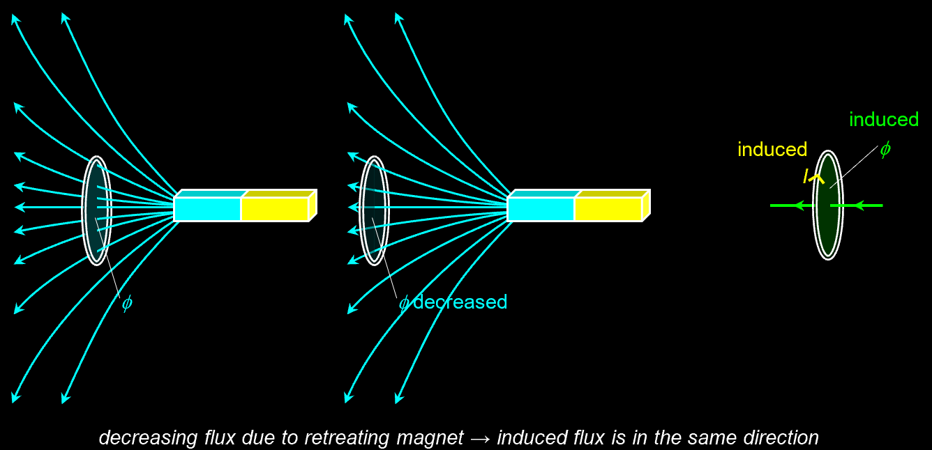
Topic : Electro Magnetic Induction
Electromagnetic induction is the creation of an electro-motive force (EMF) by way of a moving magnetic field around an electric conductor and, conversely, the creation of current by moving an electric conductor through a static magnetic field.
3 Ways to induce current in a circuit:
I. Moving a circuit into or out of a magnetic field .
II. Rotating a circuit within a magnetic field.
III. Changing the intensity and/or direction of a magnetic field.

Slide 14
Question
A conducting circular loop is placed in a uniform magnetic field, B = 0.025 T with its plane perpendicular to the loop. the radius of the loop is made to shrink at a constant rate of 1 mm s^{–1}. The induced e.m.f. when the radius is 2 cm, is
A
2 πμV
πμV
π/2 μV
2 μV
B
C
D
Notes:
Ans : B

Slide 15
Question
A conducting circular loop is placed in a uniform magnetic field of 0.04 T with its plane perpendicular to the magnetic field. The radius of the loop starts shrinking at 2 mm/s. The induced emf in the loop when the radius is 2 cm is
A
4.8 πμV
0.8 πμV
1.6 πμV
3.2 πμV
B
C
D
Notes:
Ans : D

Slide 16

Question
The magnetic flux through a circuit of resistance R changes by an amount Δφ in a time Δt. Then the total quantity of electric charge Q that passes any point in the circuit during the time Δt is represented by
$Q=R.\frac{Δϕ}{Δt}$
$Q=\frac{1}{R}.\frac{Δϕ}{Δt}$
$Q=\frac{Δϕ}{R}$
$Q=\frac{Δϕ}{Δt}$
A
B
C
D
Notes:
Ans : C

Slide 17
Question
A magnetic field of 2 × 10^{–2} T acts at right angle to a coil of area 100 cm², with 50 turns. The average e.m.f. induced in the coil is 0.1 V, when it is removed from the field in t sec. The value of t is
A
10 s
0.1 s
0.01 s
1 s
B
C
D
Notes:
Ans : B

Slide 18

Question
In a coil of resistance 10 Ω, the induced current developed by changing magnetic flux through it, is shown in figure as a function of time. The magnitude of change in flux through the coil in Weber is:
A
8
2
6
4
B
C
D
Notes:
Ans : B

Slide 19
Question
The total charge induced in a conducting loop when it is moved in a magnetic field depends on
A
the rate of change of magnetic flux
initial magnetic flux only
the total change in magnetic flux
final magnetic flux only
B
C
D
Notes:
Ans : C

Slide 20
Question
The magnetic flux linked with a coil (in Wb) is given by the equation φ = 5t² + 3t + 16 The magnitude of induced emf in the coil at t=4 second will be
[NEET (Oct.) 2020]
A
33 V
43 V
108 V
10 V
B
C
D
Notes:
Ans : B

Slide 21
Question
A coil of 800 turns effective area 0.05 m² is kept perpendicular to a magnetic field 5 × 10^{–5} T. When the plane of the coil is rotated by 90° around any of its co-planar axis in 0.1 s, the emf induced in the coil will be
[NEET 2019]
A
0.2 V
2 × 10^{–3} V
0.02 V
2V
B
C
D
Notes:
Ans : C

Slide 22
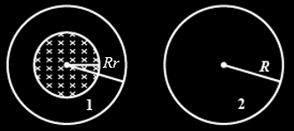

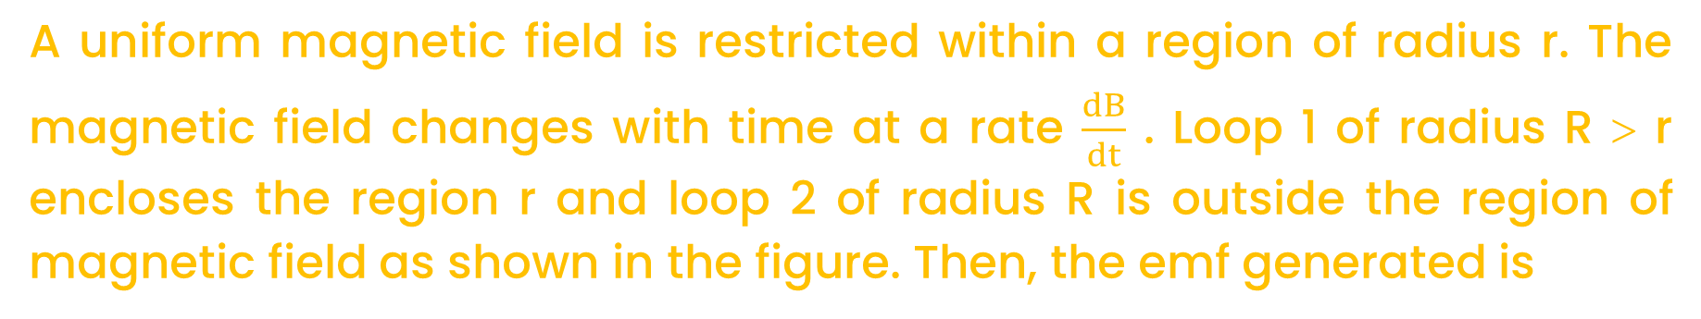
Question
A uniform magnetic field is restricted within a region of radius r. The magnetic field changes with time at a rate $\frac{dB}{dt}$ . Loop 1 of radius R > r encloses the region r and loop 2 of radius R is outside the region of magnetic field as shown in the figure. Then, the emf generated is
[NEET 2016]
A
Zero in loop 1 and zero in loop 2
$−\frac{dB}{dt}πr^{2}$ in loop 1 and $−\frac{dB}{dt}πr^{2}$ in loop 2
$−\frac{dB}{dt}πR^{2}$ in loop 1 and zero in loop 2
$−\frac{dB}{dt}πr^{2}$ in loop 1 and zero in loop 2
B
C
D
Notes:
Ans : D

Slide 23


Question
As a result of change in the magnetic flux linked to the closed loop shown in the figure, an emf V volt is induced in the loop. The work done (joule) in taking a charge q coulomb once along the loop is
[CBSE AIPMT 2005]
A
qV
zero
2 qV
$\frac{qV}{2}$
B
C
D
Notes:
Ans : A

Slide 24
Question
Faraday’s law are consequence of conservation of
[AIPMT 1991]
A
Energy
Energy and magnetic field
Charge
Magnetic Field
B
C
D
Notes:
Ans : A

Slide 25
Question
A square loop of side 10 cm and resistance 0.5Ω is placed vertically in the east-west plane. A uniform magnetic field 0.10 T is set up across the plane in the north-east direction. The magnetic field is decreased to zero in 0.70 s at a steady rate. The magnitude of induced current during this time interval is:
[NCERT]
A
2 mA
1 mA
0.5 mA
0.3 mA
B
C
D
Notes:
Ans : A

Slide 26
Question
A circular coil of radius 10 cm, 500 turns, and resistance 2Ω is placed with its plane perpendicular to the horizontal component of the earth’s magnetic field. It is rotated about its vertical diameter through 180° in 0.25 s. The magnitude of the current induced in the coil is: (The horizontal component of the earth’s field at the place is 3.0 × 10^{–5}T)
3 mA
2.5 mA
5.2 mA
1.9 mA
[NCERT]
A
B
C
D
Notes:
Ans : D

Slide 27
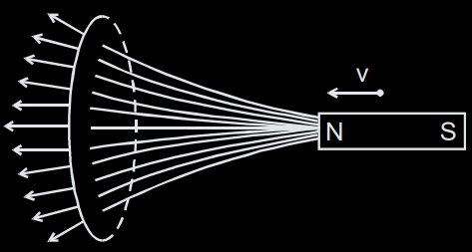
Topic : Lenz’s law (conservation of energy principle)
According to this law, emf will be induced in such a way that it will oppose the cause which has produced it.
Figure shows a magnet approaching a ring with its north pole towards the ring.

Slide 28

Question
An electron moves on a straight-line path XY as shown. The abcd is a coil adjacent to the path of electron. What will be the direction of current if any, induced in the coil?
adcb
The current will reverse its direction as electron goes past the coil
No current induced
abcd
A
B
C
D
Notes:
Ans : B

Slide 29
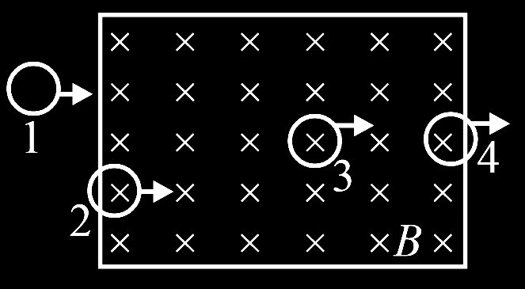
Question
A conducting loop is moving from left to right through a region of uniform magnetic (B) field. Its four positions are shown below. Show the direction of induced current in all four positions.

Slide 30
Question
A rectangular coil of 20 turns and area of cross-section 25 sq. cm has a resistance of 100 Ω. If a magnetic field which is perpendicular to the plane of coil changes at a rate of 1000 tesla per second, the current in the coil is
A
1 A
50 A
0.5 A
5 A
B
C
D
Notes:
Ans : C

Slide 31
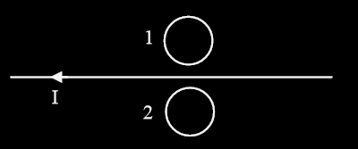
Question
Predict the direction of induced current in metal rings 1 and 2 when current I in the wire is steadily decreasing?
Notes:
Ans : Clockwise, Anticlockwise

Slide 32
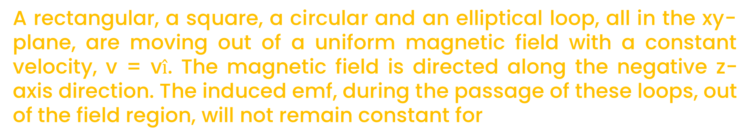
Question
A rectangular, a square, a circular and an elliptical loop, all in the xy-plane, are moving out of a uniform magnetic field with a constant velocity, v = v$\hat{i}$. The magnetic field is directed along the negative z-axis direction. The induced emf, during the passage of these loops, out of the field region, will not remain constant for
[CBSE AIPMT 2009]
A
the rectangular, circular and elliptical loops
the circular and the elliptical loops
only the elliptical loop
any of the four loops
B
C
D
Notes:
Ans : B

Slide 33
Question
In a region of uniform magnetic induction B = 10² T, a circular coil of radius 30 cm and resistance π² ohm is rotated about an axis which is perpendicular to the direction of B and which forms a diameter of the coil. If the coil rotates at 200 rpm the amplitude of the alternating current induced in the coil is
[CBSE AIPMT 1988]
A
4 π² mA
30 mA
6 mA
200 mA
B
C
D
Notes:
Ans : C

Slide 34
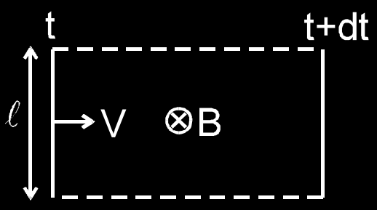
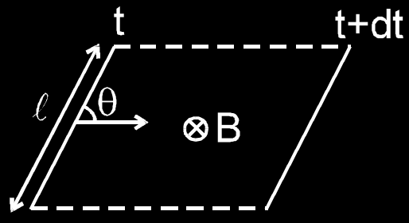
Topic : Motional EMF

Slide 35
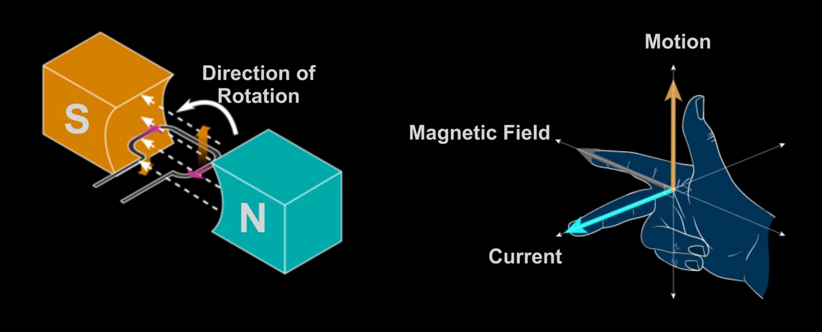
Topic : Motional EMF

Slide 36
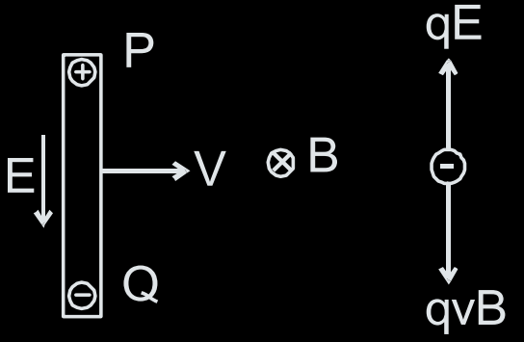

Topic : Explanation of emf induced in rod on the basis of magnetic force
If a rod is moving with velocity v in a magnetic field B ,as shown , the free electrons in a rod will experience a magnetic force in downward direction and hence free electrons will accumulate at the lower end and there will be a deficiency of free electrons and hence a surplus of positive charge at the upper end. These charges at the ends will produce an electric field in downward direction which will exert an upward force on electron. If the rod has been moving for quite some time enough charges will accumulate at the ends so that the two forces qE and qvB will balance each other. Thus E = v B.
$V_{P}–V_{Q}=VBℓ$

Slide 37
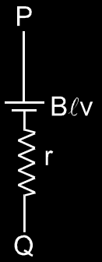
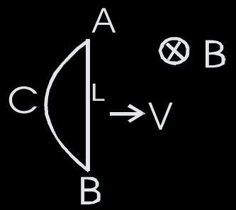
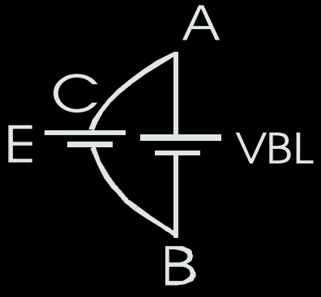
The Moving rod is Equivalent to the Following Diagram, Electrically

Slide 38


Question
A rod AB slides on a V shaped wire with speed v as shown, such that at any time OA = OB = l. Magnetic field in the region is perpendicular downwards and has strength B, induced emf in the rod is
A
Zero
Bvl
$\frac{\sqrt{3}Bvl}{2}$
$\frac{Bvl}{2}$c
B
C
D
Notes:
Ans : B

Slide 39
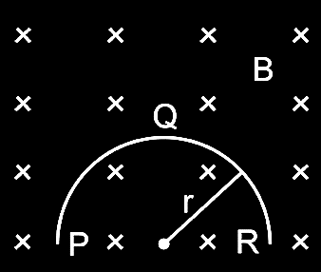
Question
A thin semicircular conducting ring (PQR) of radius r is falling with its plane vertical in a horizontal magnetic field B, as shown in figure. The potential difference developed across the ring when its speed is v is
A
Zero
BvπI²/2 and P is at higher potential
πrBv and R is at higher potential
2 rBv and R is at higher potential
B
C
D
Notes:
Ans : D

Slide 40
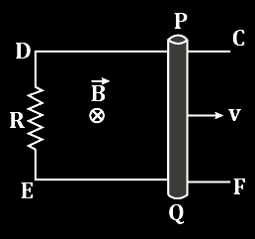
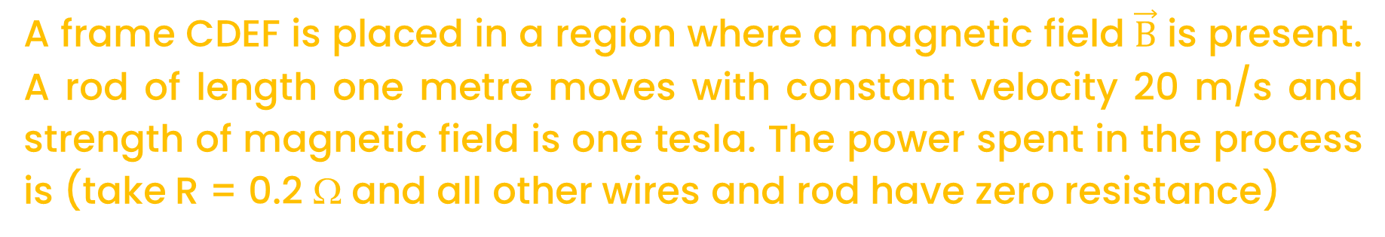
Question
A frame CDEF is placed in a region where a magnetic field $\vec{B}$ is present. A rod of length one metre moves with constant velocity 20 m/s and strength of magnetic field is one tesla. The power spent in the process is (take R = 0.2 Ω and all other wires and rod have zero resistance)
A
1 kW
2 kW
3 kW
4 kW
B
C
D
Notes:
Ans : B

Slide 41
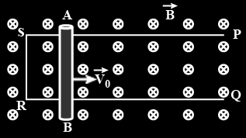
Question
A conducting rod AB of length l is projected on a frictionless frame PSRQ with velocity v₀ at any instant. The velocity of the rod after time t is
A
v = v₀
v > v₀
v < v₀
None of these
B
C
D
Notes:
Ans : C

Slide 42
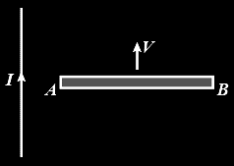
Question
The current carrying wire and the rod AB are in same plane. The rod moves parallel to the wire with a velocity v. Which one of the following statement is true about induced emf in the rod ?
A
End A will be at lower potential with respect to B
A and B will be at same potential
There will be no induced emf in the rod
Potential at A will be higher than that at B
B
C
D
Notes:
Ans : D

Slide 43
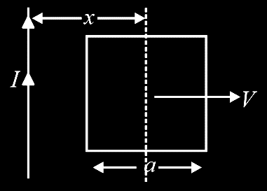

Question
A conducting square frame of side a and a long straight wire carrying current I are located in the same plane as shown in the figure. The frame moves to the right with a constant velocity V. The emf induced in the frame will be proportional to
$\frac{1}{(2x−a)^{2}}$
$\frac{1}{(2x+a)^{2}}$
$\frac{1}{(2x−a)(2x+a)}$
$1/x^{2}$
A
B
C
D
Notes:
Ans : C

Slide 44
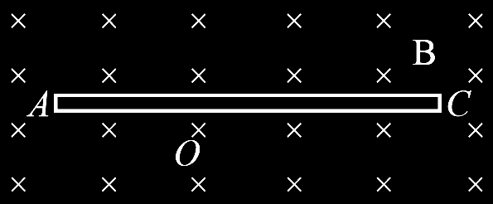

Question
A conducting rod AC of length 4l is rotated about a point O in a uniform magnetic field B directed into paper. AO = l and OC = 3l. Then
$V_{A}−V_{O}=\frac{Bωl^{2}}{2}$
$V_{O}−V_{c}=\frac{7}{2}Bωl^{2}$
$V_{A}−V_{C}=4Bωl^{2}$
$V_{C}−V_{O}=\frac{9}{2}Bωl^{2}$
A
B
C
D
Notes:
Ans : C

Slide 45

Question
A conducting rod PQ of length L = 1.0 m is moving with a uniform speed v = 2 ms^{–1} in a uniform magnetic field B = 4.0 T directed into the paper. A capacitor of capacity C = 10 μF is connected as shown in figure. Then
A
q_{A} = +80 μC and q_{B} = –80 μC
q_{A} = –80 μC and q_{B} = +80 μC
q_{A} = 0 = q_{B}
Charge stored in the capacitor increases exponentially with time
B
C
D
Notes:
Ans : A

Slide 46
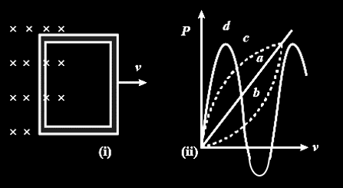
Question
A conducting loop being pulled out of magnetic field with a speed v. Which of the following plots may represents the power delivered by the pulling agent as a function of the speed v?
A
a
b
c
d
B
C
D
Notes:
Ans : B

Slide 47
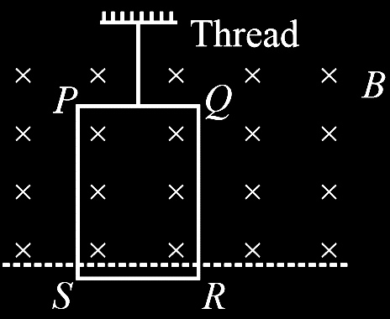




Question
A rectangular conducting loop, PQRS is hanging from a thread as shown. Thread is now cut Compute velocity with which the loop falls as function of time t. If side PS is large enough the loop ultimately falls with constant speed, (m = mass of loop, r = Resistance of loop, PQ = l, PS = b) then find that velocity.
$$\frac{rmg}{B^{2}l^{2}}$$
$$\frac{mg}{Bl}$$
A
B
$$\frac{rmg}{B^{2}}$$
$$\frac{rmg}{l^{2}}$$
C
D
Notes:
Ans : A

Slide 48
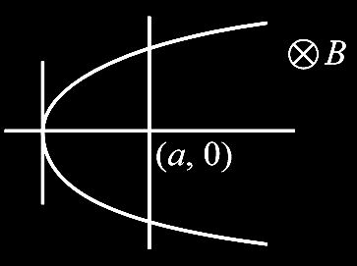
Question
The wire is shaped like a parabola y² = 4ax at the instant the rod crosses the point (a, 0). Induced emf in the rod is
A
Bav
2 Bav
3 Bav
4 Bav
B
C
D
Notes:
Ans : D

Slide 49




Question
A rod of mass m and length l is in contact vertical rails connected with resistance R on other end. There is a horizontal magnetic field B₀ perpendicular to the rod. Find terminal velocity of rod while falling down.
$$\frac{mgR}{B^{2}l^{2}}$$
$$\frac{2mgR}{B^{2}l^{2}}$$
A
B
$$\frac{3mgR}{B^{2}l^{2}}$$
$$\frac{4mgR}{B^{2}l^{2}}$$
C
D
Notes:
Ans : A

Slide 50
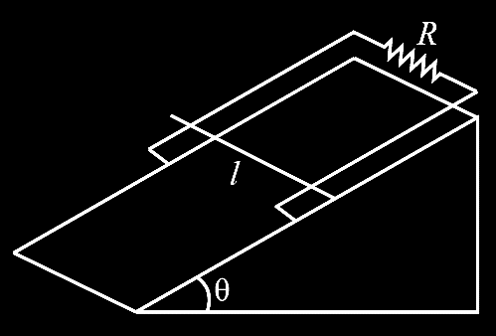




Question
A rod of length l and mass m is placed on an inclined wedge of angle θ. The rails are connected by a resistance R on the other end. Find terminal velocity of the rod (B is vertically up)
$$\frac{mgR}{B^{2}l^{2}}\frac{\sin^{1}⁡θ}{\cos^{2}⁡θ}$$
$$\frac{4mgR}{B^{2}l^{2}}\sin^{2}⁡θ$$
A
B
$$\frac{mgR}{B^{2}l^{2}}cos⁡θ$$
$$\frac{4mgR}{B^{2}l^{2}}cos⁡θ$$
C
D
Notes:
Ans : A

Slide 51
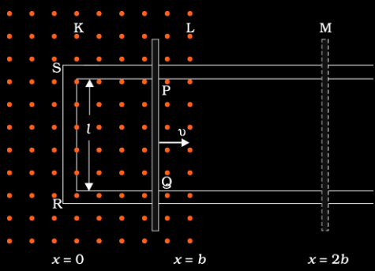
Question
Refer to figure. The arm PQ of the rectangular conductor is moved from x = 0, outwards. The uniform magnetic field is perpendicular to the plane and extends from x = 0 to x = b and is zero for x > b. Only the arm PQ possesses substantial resistance r. Consider the situation when the arm PQ is pulled outwards from x = 0 to x = 2b with a constant speed v. The induced emf is:
[NCERT]
A
– Blv for 0 < x < b, 0 for b < x < 2b
+ Blv for 0 < x < b, 0 for b < x < 2b
– Blv for b < x < 2b, 0 for 0 < x < b
+ Blv for b < x < 2b, 0 for 0 < x < b
B
C
D
Notes:
Ans : A

Slide 52
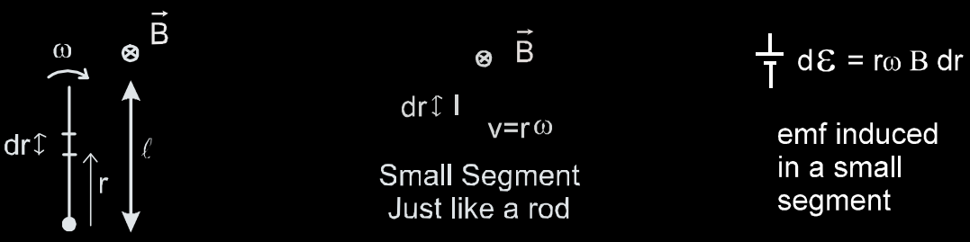
Topic : Induced Emf Due to Rotation
4.1 ROTATION OF THE ROD
Consider a conducting rod of length l rotating in a uniform magnetic field

Slide 53
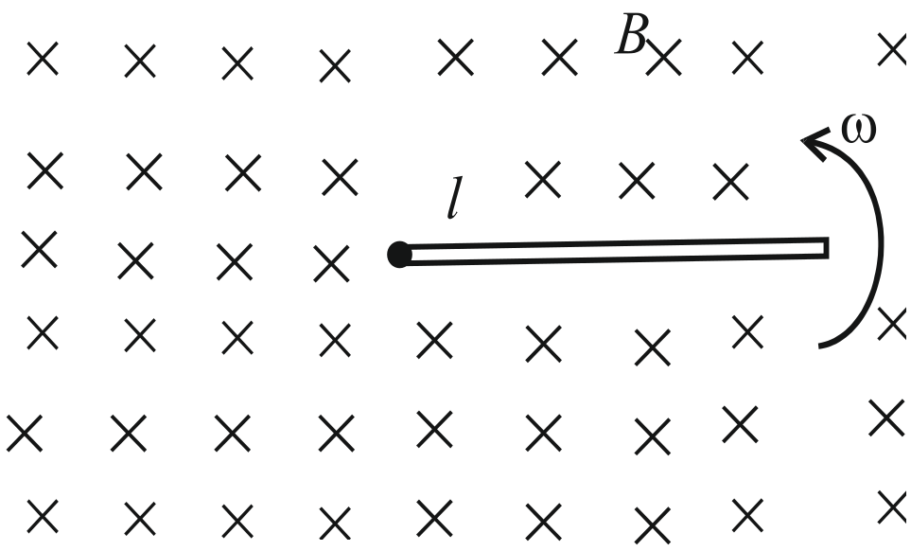
Topic : Motional emf due to rotational motion of conducting rod
$ε_{motional}=\frac{1}{2}Bωl^{2}$

Slide 54
Question
A conducting rod OA of length l is rotated about its end O with an angular velocity ω in a uniform magnetic field directed perpendicular to the plane of rotation. Find the emf induced in the rod, between it’s ends.
Notes:
Ans : $\frac{Bωl^{2}}{2}$

Slide 55

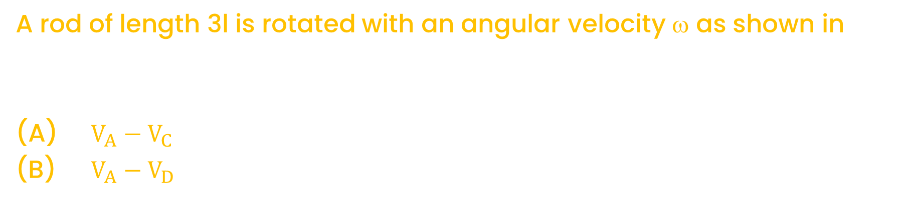
Question
A rod of length 3l is rotated with an angular velocity ω as shown in
(A) $V_{A}−V_{C}$
(B) $V_{A}−V_{D}$
Notes:
Ans : $(a)$ $V_{A}−V_{C}=\frac{Bωl^{2}}{2}$, (b) $V_{A}−V_{D}=−\frac{3Bωl^{2}}{2}$

Slide 56

Question
A metallic rod of 1 m length is rotated with a frequency of 50 rev/s, with one end hinged at the centre and the other end at the circumference of a circular metallic ring of radius 1 m, about an axis passing through the centre and perpendicular to the plane of the ring (Figure). A constant and uniform magnetic field of 1 T parallel to the axis is present everywhere. What is the emf between the centre and the metallic ring ?
Notes:
Ans : 50 π V

Slide 57
Question
An aeroplane rises vertically with a speed of 100 m/s. The aeroplane has wings span 10 m and horizontal component of earth’s magnetic field perpendicular to wings is 5 × 10^{–3} Wb/m². The induced emf across the ends of wings is
A
50 V
0.5 V
5 V
25 V
B
C
D
Notes:
Ans : C

Slide 58
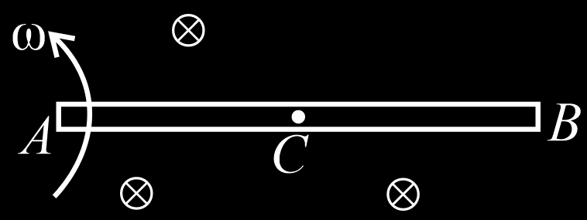




Question
A copper rod AB of length l, pivoted at one end A, rotates at constant angular velocity ω, at right angles to a uniform magnetic field of induction B. The emf, developed between the midpoint C of the rod and end B is
$$\frac{Bωl^{2}}{8}$$
$$\frac{3}{4}Bωl^{2}$$
A
B
$$\frac{Bωl^{2}}{4}$$
$$\frac{3}{8}Bωl^{2}$$
C
D
Notes:
Ans : D

Slide 59





Question
A semi-circular loop of radius R is rotated with an angular velocity perpendicular to the plane of a magnetic field B as shown in the figure. Emf induced in the loop is
$$BωR^{2}$$
$$\frac{1}{2}BωR^{2}$$
A
B
$$\frac{3}{2}BωR^{2}$$
$$\frac{1}{4}BωR^{2}$$
C
D
Notes:
Ans : B

Slide 60


Question
A simple pendulum with bob of mass m conducting wire of length L swings under gravity through an angle 2θ. The earth’s magnetic field component in the direction perpendicular to swing is B. The maximum potential difference induced across the pendulum is
A
2 BL $\sin\left(\frac{θ}{2}\right)⋅\sqrt{gL}$
$BL sin\left(\frac{θ}{2}\right)\sqrt{gL}$
$BLsin\left(\frac{θ}{2}\right)⋅(gL)^{3/2}$
$BLsin\left(\frac{θ}{2}\right)⋅(gL)^{2}$
B
C
D
Notes:
Ans : B

Slide 61
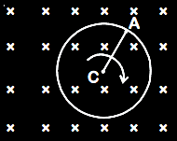
Question
A cycle wheel of radius 0.5 m is rotated with constant angular velocity of 10 rad/s in a region of magnetic field of 0.1 T which is perpendicular to the plane of the wheel. The EMF generated between its centre and the rim is
A
zero
0.25 V
0.125 V
0.5 V
B
C
D
Notes:
Ans : C

Slide 62


Question
A uniform but time varying magnetic field is present in a cylindrical region of radius R. The magnetic field is perpendicular and into the plane of the loop and the magnitude of field is increasing at a constant rate α. There is a straight conducting rod of length 2R placed as shown in figure. The magnitude of induced emf across the rod is
A
$πR^{2}α$
$πR^{2}α/2$
$R^{2}α/\sqrt{2}$
$πR^{2}α/4$
B
C
D
Notes:
Ans : D

Slide 63
Question
Kamla peddles a stationary bicycle. The pedals of the bicycle are attached to a 100 turn coil of a area of 0.10 m². The coil rotates at half a revolution per second and it is placed in a uniform magnetic field of 0.01 T perpendicular to the axis of rotation of the coil. What is the maximum voltage generated in the coil ?
[NCERT]
A
0.628 V
0.421 V
0.314 V
0
B
C
D
Notes:
Ans : C

Slide 64
Question
A wheel with 10 metallic spokes each 0.5 m long is rotated with a speed of 120 rev/min in a plane normal to the horizontal component of earth’s magnetic field H_{E} at a place. If H_{E}=0.4 G at the place, what is the induced emf between the axle and the rim of the wheel?
(1 G = 10^{–4} T)
[NCERT]
A
5.12 × 10^{–5} V
0
3.33 × 10^{–5} V
6.28 × 10^{–5} V
B
C
D
Notes:
Ans : D

Slide 65
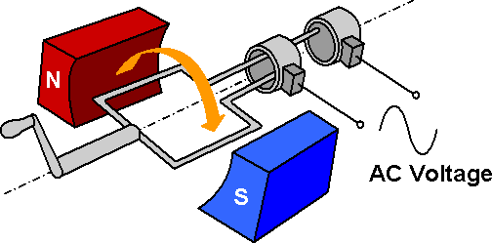
Topic : AC Generator

Slide 66
Question
The working of AC Generator is based on the principle of
A
Electromagnetic induction
Mutual Induction
Self-induction
Lenz’s law
B
C
D
Notes:
Ans : A

Slide 67
Question
An electric generator converts
A
Electric energy into light energy
Mechanical energy into electric energy
Electric energy into sound energy
Electric energy into mechanical energy
B
C
D
Notes:
Ans : B

Slide 68
Question
If the rotational velocity of a dynamo armature is doubled, then the induced emf will
A
become half
become double
remain unchanged
None of the above
B
C
D
Notes:
Ans : B

Slide 69
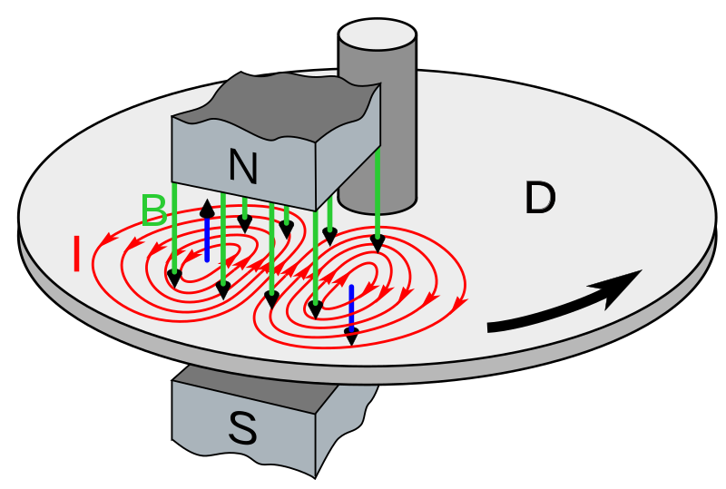
Topic : Eddy Current
Eddy current is induced in a bulk piece of conductor when it is placed in a changing magnetic field or when a conductor is moved in a magnetic field and/or both. Any imagined circuit within the conductor will change its magnetic flux linkage and the subsequent induced emf. will drive current around the circuit. Thus the alternating magnetic flux induces eddy currents in the iron core and causes heating. The effect is reduced by laminating, lamination, slotting process the resistance path for circulating of Eddy current increases, resulting into weaking them and also reducing losses i.e, the core is made of this sheets of iron with insulating sheets between them so that the circuits for the eddy currents are broken.

Slide 70
Topic : Advantage Eddy Current
1. Electric break
2. Induction furnace
3. Energy meter
4. Speedo meter

Slide 71
Question
Eddy currents are produced when
A
a metal is kept in varying magnetic field
a metal is kept in steady magnetic field
a circular coil is placed in a magnetic field
through a circular coil, current is passed
B
C
D
Notes:
Ans : A

Slide 72
Question
In which of the following devices, the eddy current effect is not used?
A
Induction furnace
Magnetic braking in train
electromagnet
electric heater
B
C
D
Notes:
Ans : D

Slide 73

Topic : Induced Electric Field
When Magnetic field changes with time in region then the electric field induces with in and outside the region.

Slide 74

Topic : Properties
This field is different from the conservative Electro-static field
It is non conservative force field.
It’s field line are always in closed loop.
F = QE, is valid for the field.
For one complete loop Potential will not equal to zero.
${\oint{\vec{E}}}_{ind}.d\vec{𝓁}≠0$ (For new field), ${\oint{\vec{E}}}_{ind}.d\vec{𝓁}=0$ (For old field)
Direction of induce electric field is same as the direction of induce current.

Slide 75
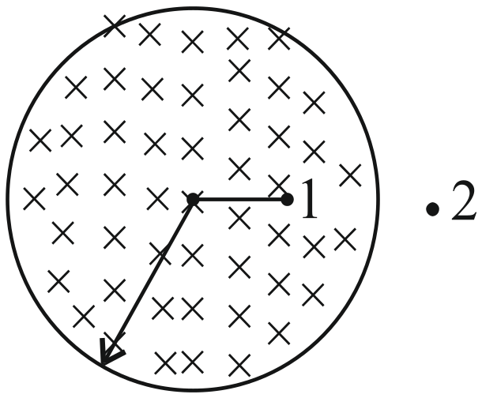

Topic : Finding Electric Field
Case-I (r < R)
$$E=\frac{r}{2}\frac{dB}{dt}$$
Case-II (r > R)
$$E=\frac{R2}{2r}\frac{dB}{dt}$$

Slide 76
Question
Flux linked through following coils changes with respect to time them for which coil an e.m.f. is not induced
A
Copper coils
Wood coils
Iron coils
None
B
C
D
Notes:
Ans : D

Slide 77


